Slide 1

Classification

Slide 2
Classification
Notes:
приветы

Slide 3
Week goals
What is classification
Which loss functions are used to train linear classifiers
How to measure performance of a classifier
What is Logistic regression and SVM models and how they are connected to linear classifier with error rate as a loss function

Slide 4
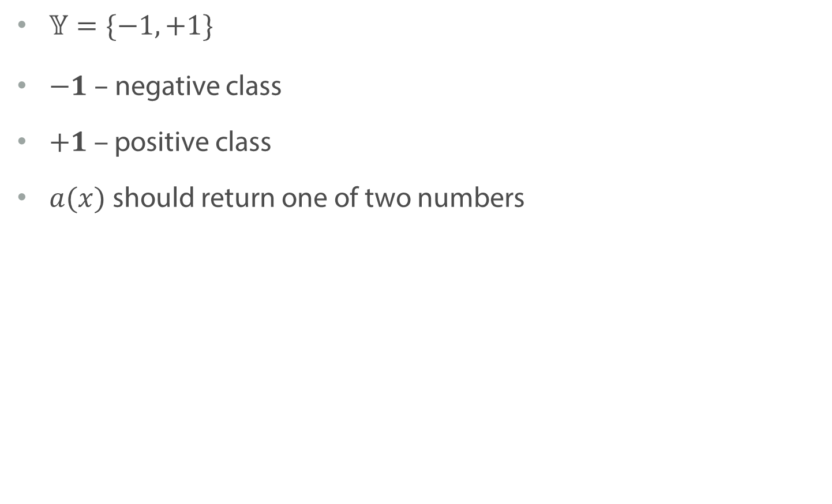
Binary Classification
$𝕐=\{−1, +1\}$
$−1 –$ negative class
$+1$ – positive class
$a(x)$should return one of two numbers
Notes:
Let us see, what kind of model can we get, that it will satisfy this

Slide 5
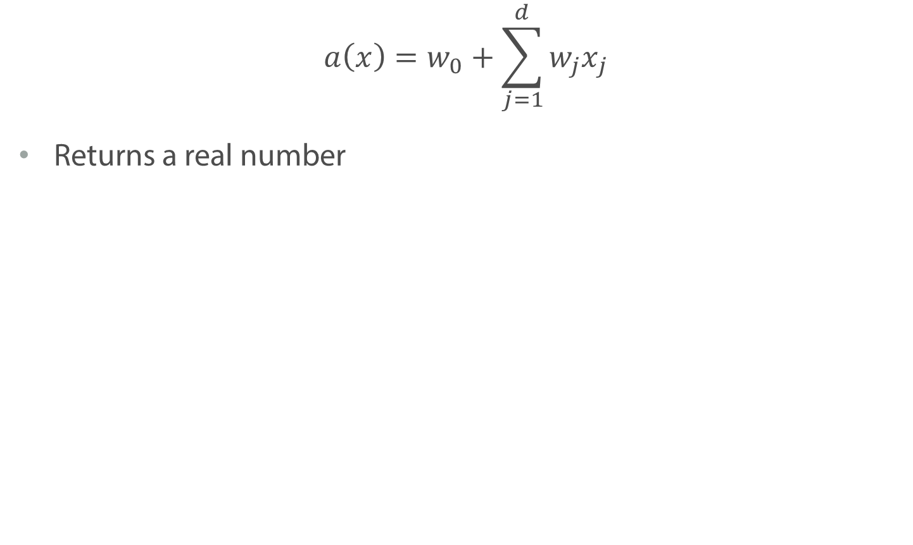
Linear Classifier
$$a\left(x\right)=w_{0}+\sum_{j=1}^{d}{w_{j}x_{j}}$$
Returns a real number
Notes:
Recall linear regression. Here is the problem

Slide 6
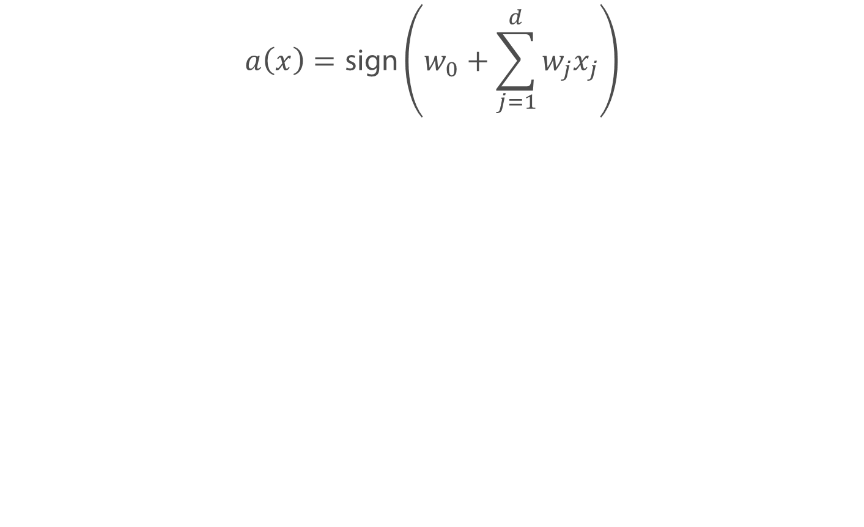
Linear Classifier
$$a\left(x\right)=\text{sign}\left(w_{0}+\sum_{j=1}^{d}{w_{j}x_{j}}\right)$$
Notes:
But here is what we can do instead

Slide 7
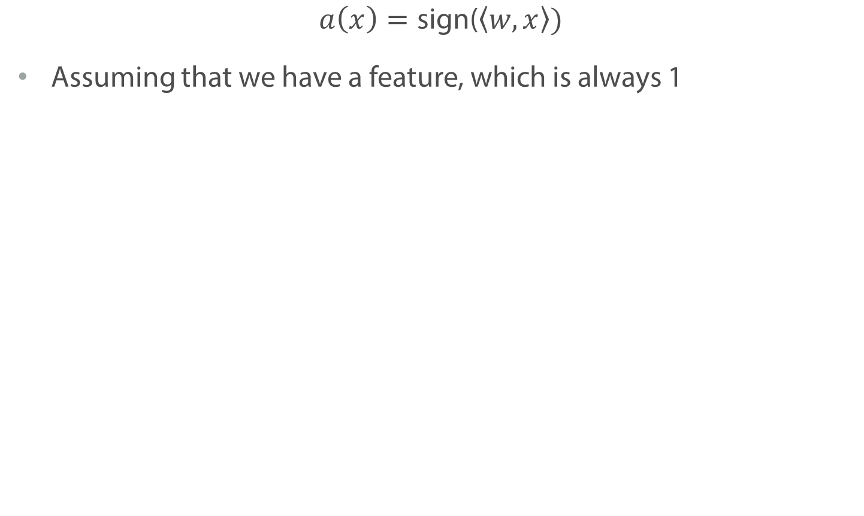
Linear Classifier
$$a\left(x\right)=\text{sign}\text{(}\left\langle w, x\right\rangle )$$
Assuming that we have a feature, which is always 1
Notes:
Lets us understand, what such model intuitively mean

Slide 8
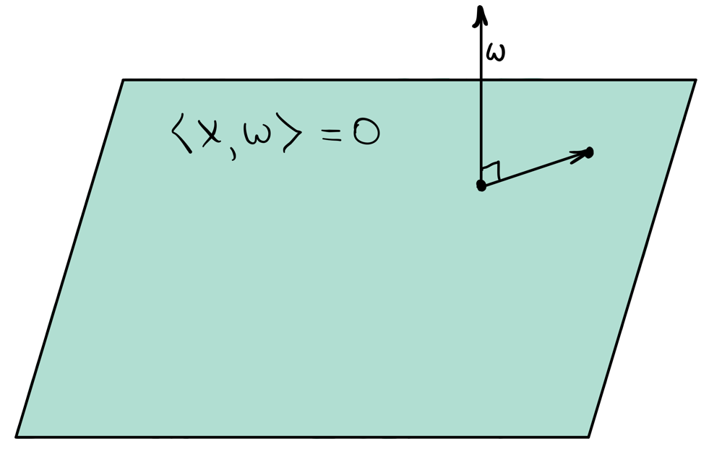
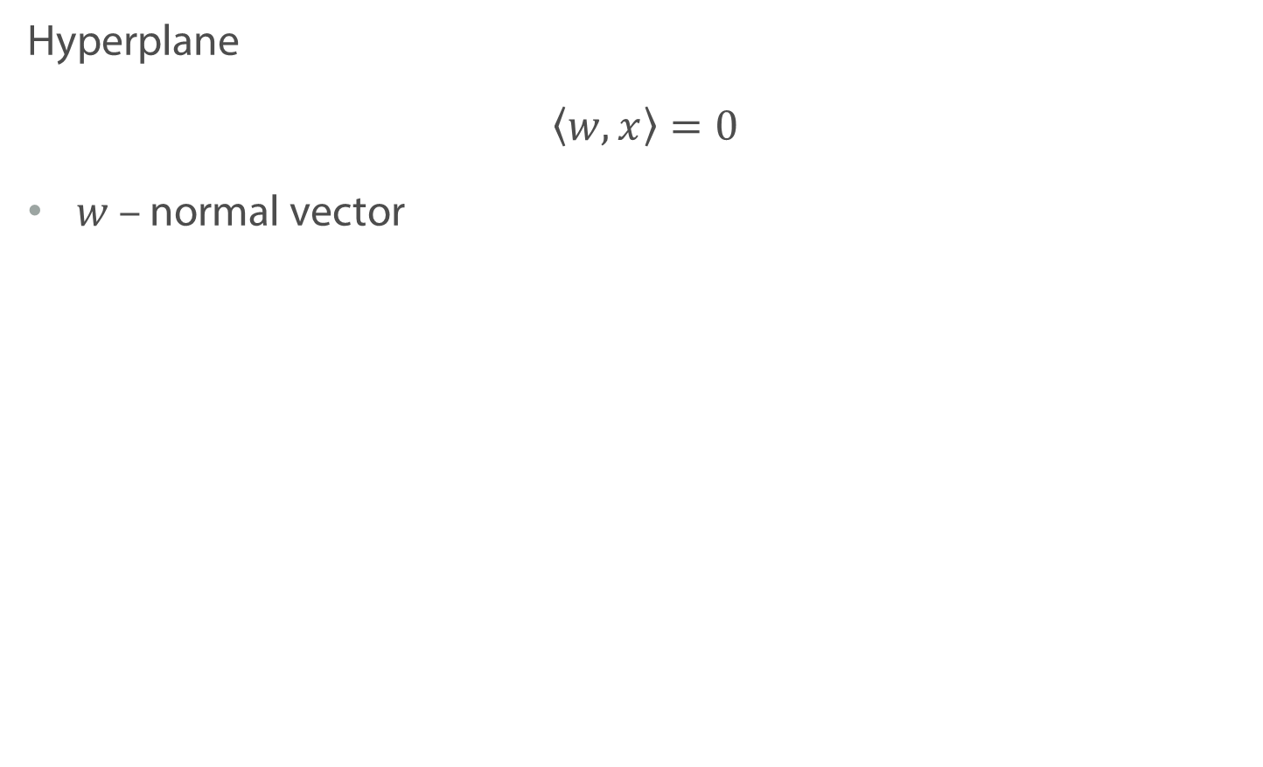
Linear Classifier
Hyperplane
$$\left\langle w, x\right\rangle =0$$
$w$ – normal vector
Notes:
As you hopefully remember from the linear algebra course, this scalar product defines a hyperplane with normal vector w. E.g. if we have 2 feature, than it would be a line. If three – a plane and so on.
Normal vector, which is a vector of coefficient in out case show the direction, perpendicular to this palne.

Slide 9
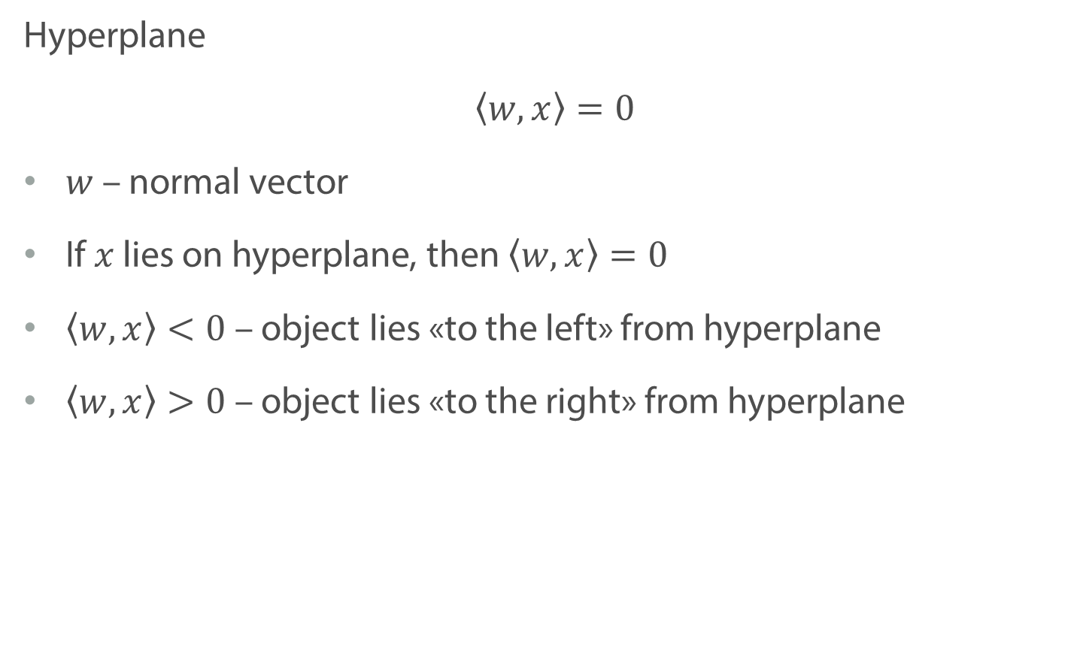
Linear Classifier
Hyperplane
$$\left\langle w, x\right\rangle =0$$
$w$ – normal vector
If $x$ lies on hyperplane, then $\left\langle w, x\right\rangle =0$
$\left\langle w, x\right\rangle <0$ – object lies «to the left» from hyperplane
$\left\langle w, x\right\rangle >0$ – object lies «to the right» from hyperplane
Notes:
Let us recap what else we know from LA about this object called hyperplane.
1. We know that the is the point lies on a hyperplane
2. If scalar product is negative, then
Here left and right are very vague concepts and you can this of right as a direction to which your vector w points to. But the main thing here is that the sign shows on which side point lies. And the value itself – how far it

Slide 10
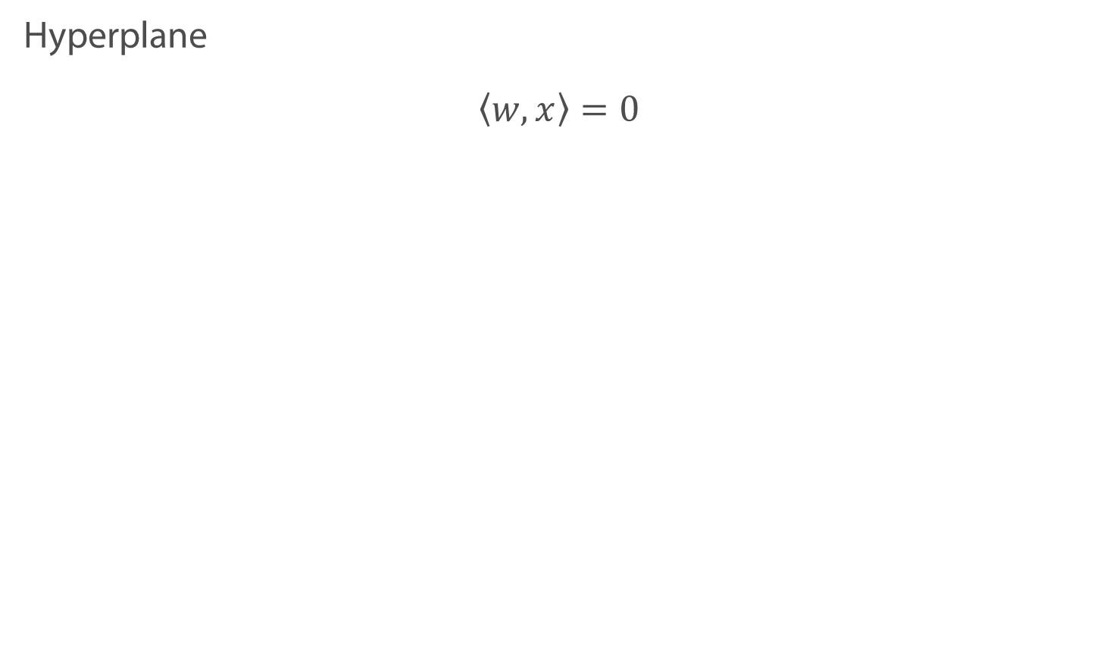
Linear Classifier
Hyperplane
$$\left\langle w, x\right\rangle =0$$
Notes:
For example if we have two features, the scalar product will define a line. With all the red dots giving negative scalar product and black dots – positive scalar product

Slide 11
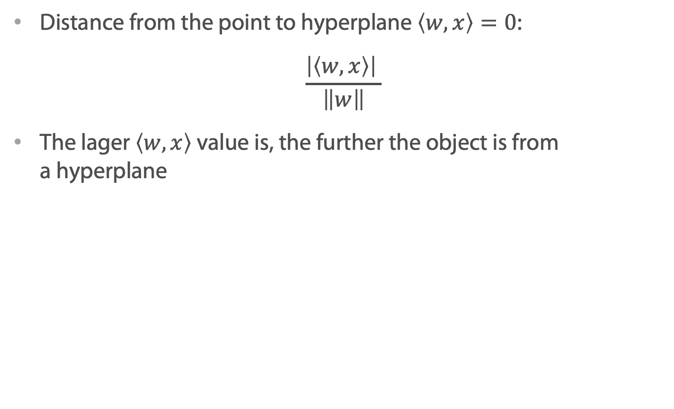
Margin
Distance from the point to hyperplane $\left\langle w, x\right\rangle =0$:
$$\frac{\left|\left\langle w, x\right\rangle \right| }{\left\|w\right\|}$$
The lager $\left\langle w, x\right\rangle$ value is, the further the object is from a hyperplane
Notes:
As you remember absolute value of <> is proportional to the distance.

Slide 12
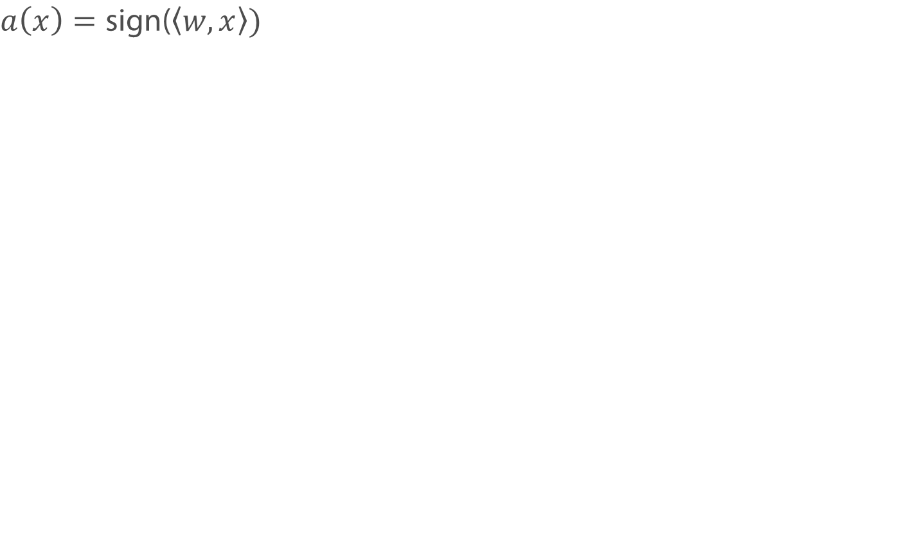
Margin
$$a\left(x\right)=\text{sign}\text{(}\left\langle w, x\right\rangle )$$
Notes:
Нарисовать <> > 0, сделать легенду с метками.

Slide 13
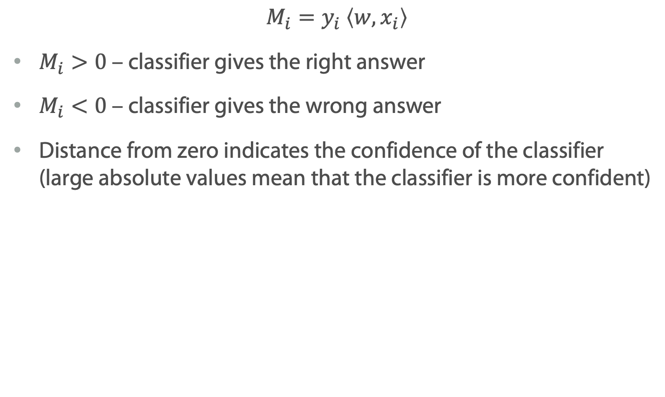
Margin
$$M_{i}=y_{i} \left\langle w, x_{i}\right\rangle$$
$M_{i}>0$ – classifier gives the right answer
$M_{i}<0$ – classifier gives the wrong answer
Distance from zero indicates the confidence of the classifier (large absolute values mean that the classifier is more confident)
Notes:
Now, of the sign of a scalar product and a object label coincide, then we can say that the linear classifier is right.

Slide 14
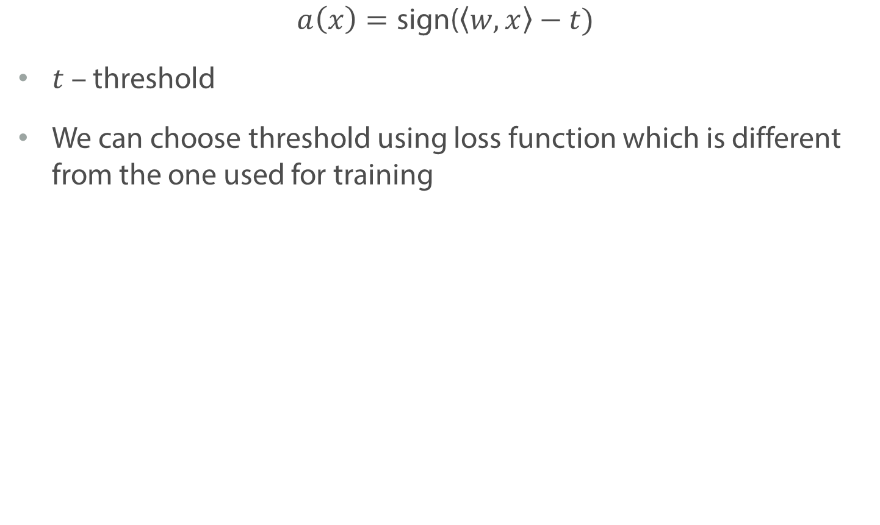
Threshold
$$a\left(x\right)=\text{sign}\text{(}\left\langle w, x\right\rangle −t)$$
$t$ – threshold
We can choose threshold using loss function which is different from the one used for training
Notes:
By far we’ve been only saying that we want to attribute all objects on one side of a hyperplane to one class and on the other side – to another. But we also noted, that the model may be rather uncertain about the objects, which are close to the border.
If in your classification task, you have some preference, objects of which class you definitely don’t wanna miss, you can select threshold which is not zero. For example. If you classifying healthy and non-healthy people.
Later, we will discuss such example in more details and see, how to choose the threshold using a loss which is different from you training loss.

Slide 15
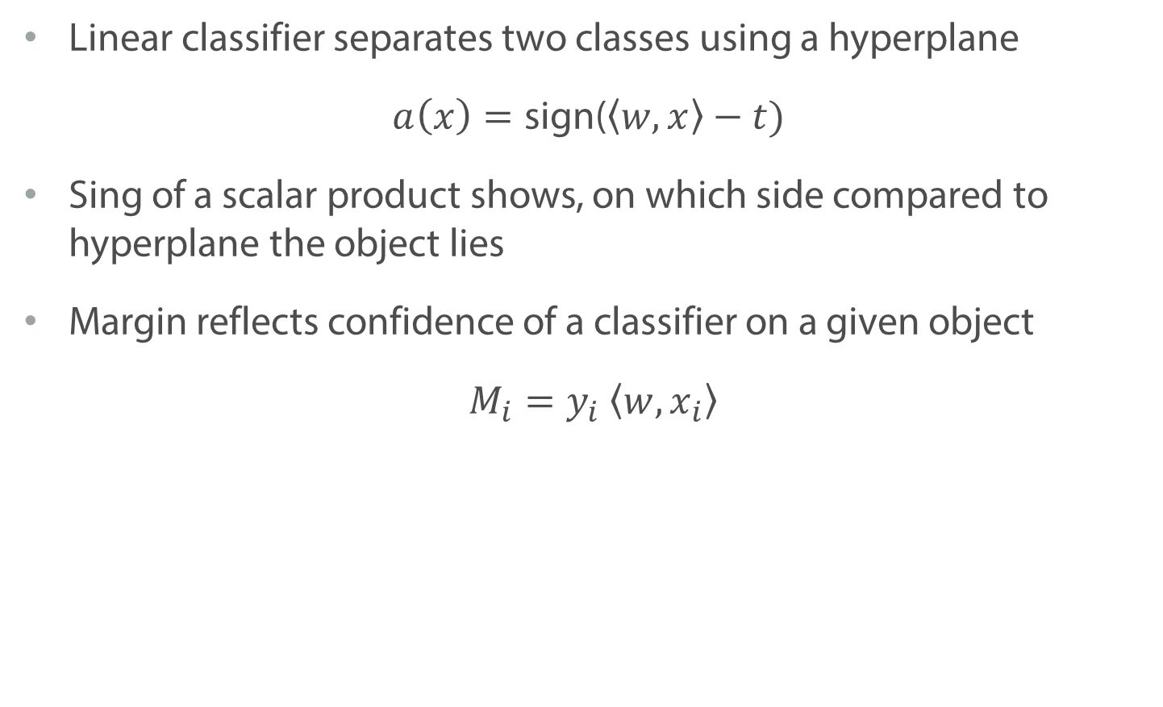
Summary
Linear classifier separates two classes using a hyperplane
$$a\left(x\right)=\text{sign}\text{(}\left\langle w, x\right\rangle −t)$$
Sing of a scalar product shows, on which side compared to hyperplane the object lies
Margin reflects confidence of a classifier on a given object
$$M_{i}=y_{i} \left\langle w, x_{i}\right\rangle$$

Slide 16
Training Linear Classifiers

Slide 17
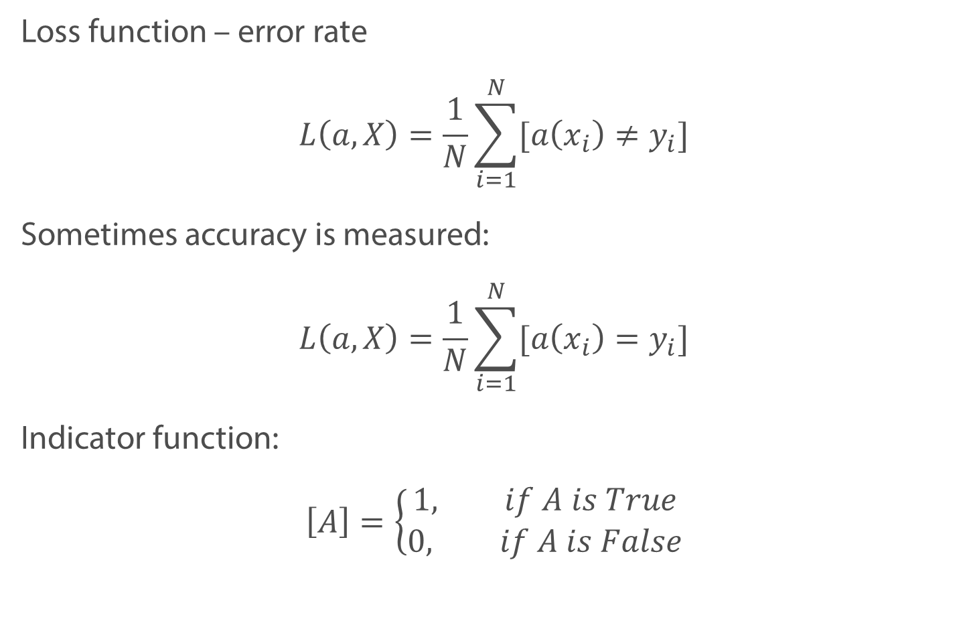
Loss function in classification
Loss function – error rate
$$L\left(a, X\right)=\frac{1}{N}\sum_{i=1}^{N}{[a\left(x_{i}\right)≠y_{i}]}$$
Sometimes accuracy is measured:
$$L\left(a, X\right)=\frac{1}{N}\sum_{i=1}^{N}{[a\left(x_{i}\right)=y_{i}]}$$
Indicator function:
$$\left[A\right]=\left\{\begin{aligned}1, if A is True \\ 0, if A is False\end{aligned}\right.$$
Notes:
Add definition of indicator

Slide 18
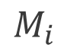
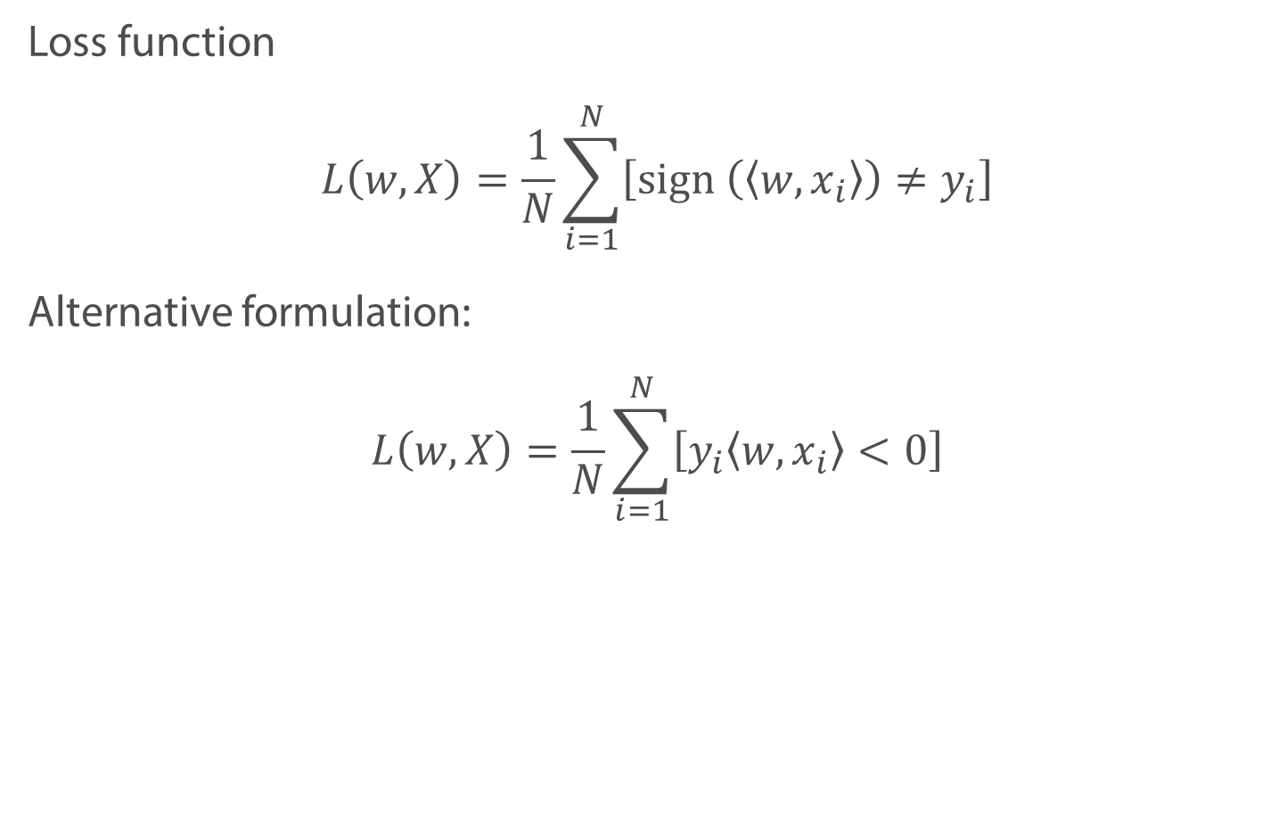
Margin
Loss function
$$L\left(w, X\right)=\frac{1}{N}\sum_{i=1}^{N}{\left[\text{sign} \left(\left\langle w, x_{i}\right\rangle \right)≠y_{i}\right]}$$
Alternative formulation:
$$L\left(w, X\right)=\frac{1}{N}\sum_{i=1}^{N}{\left[y_{i}\left\langle w, x_{i}\right\rangle <0\right]}$$
$$M_{i}$$

Slide 19
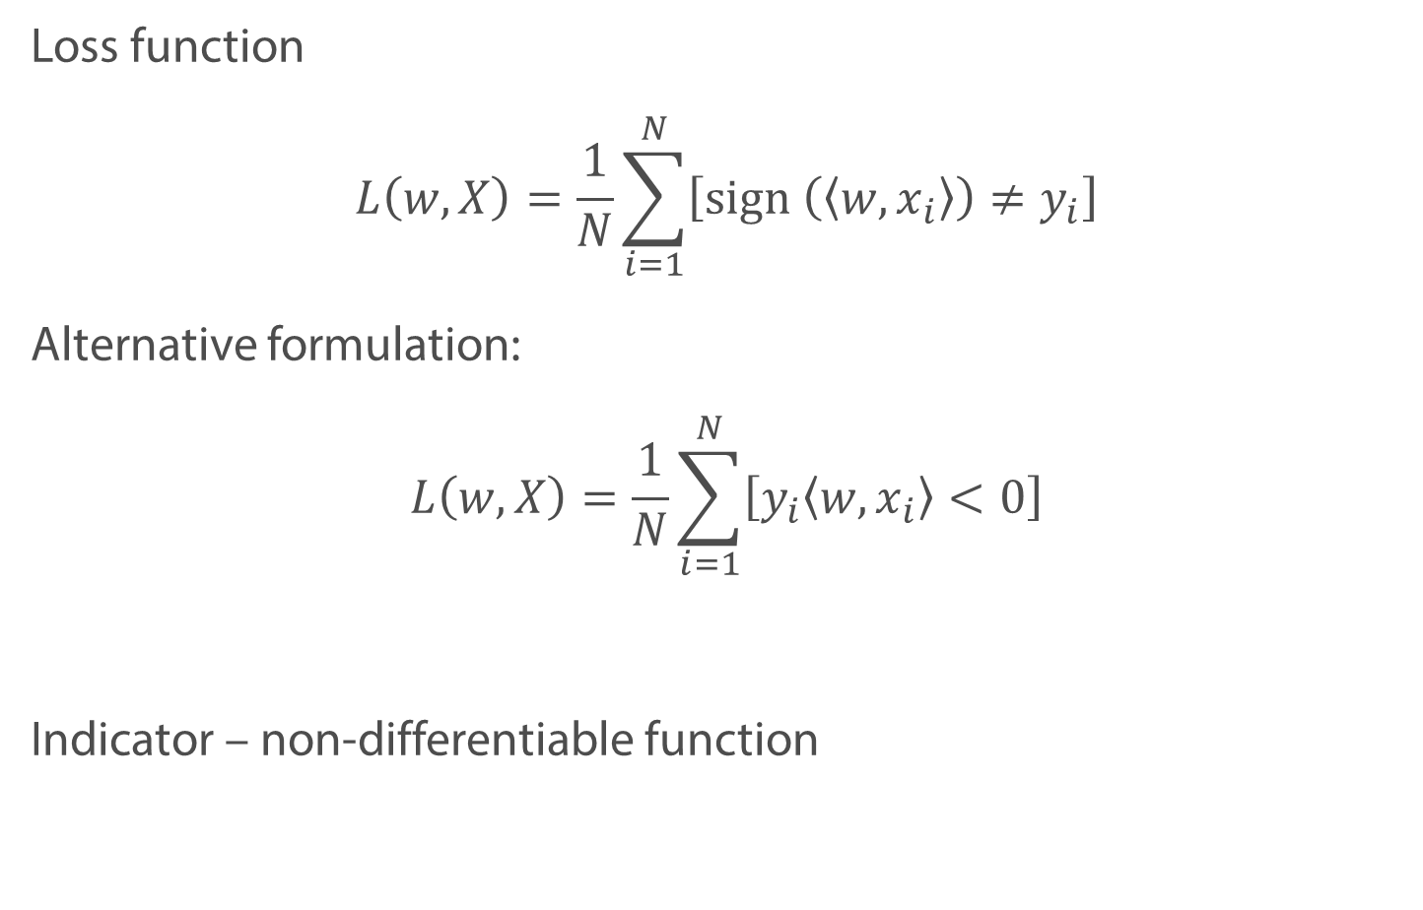
Margin
Loss function
$$L\left(w, X\right)=\frac{1}{N}\sum_{i=1}^{N}{\left[\text{sign} \left(\left\langle w, x_{i}\right\rangle \right)≠y_{i}\right]}$$
Alternative formulation:
$$L\left(w, X\right)=\frac{1}{N}\sum_{i=1}^{N}{\left[y_{i}\left\langle w, x_{i}\right\rangle <0\right]}$$
Indicator – non-differentiable function
$$M_{i}$$

Slide 20
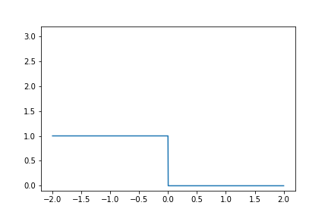
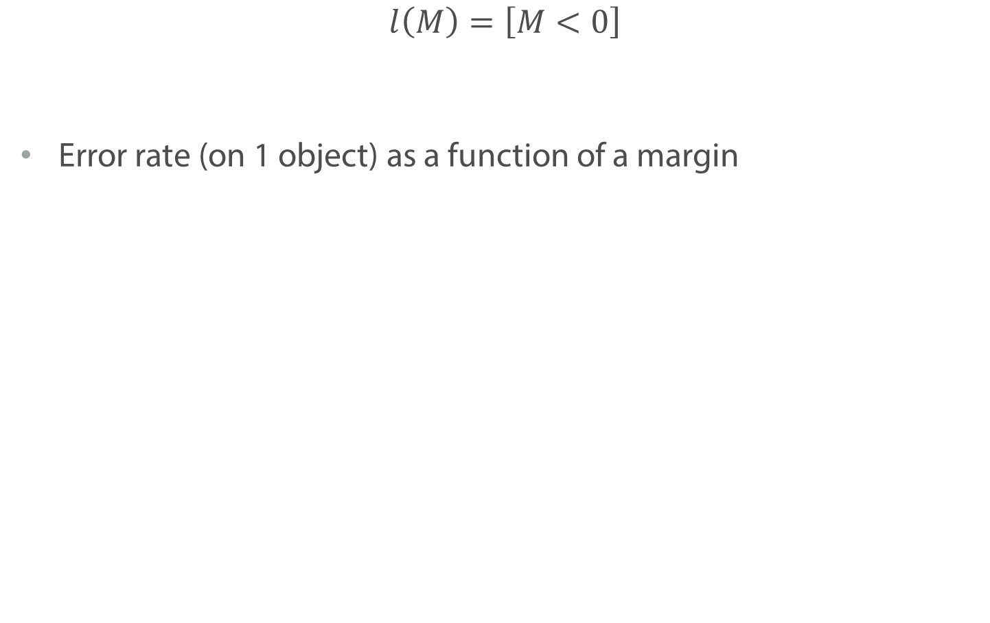
Margin
$$l\left(M\right)=\left[M<0\right]$$
Error rate (on 1 object) as a function of a margin

Slide 21
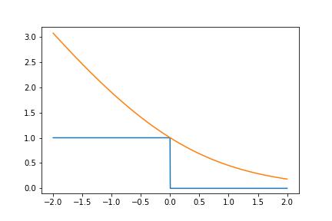
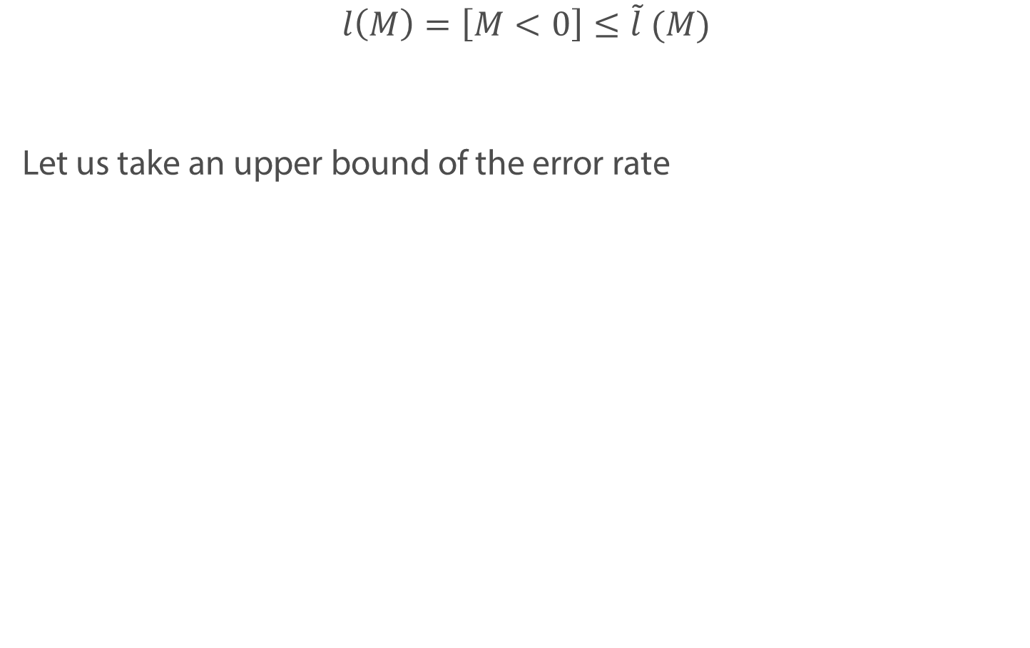
Upper bound
$$l\left(M\right)=\left[M<0\right]≤\tilde{l} (M)$$
Let us take an upper bound of the error rate

Slide 22
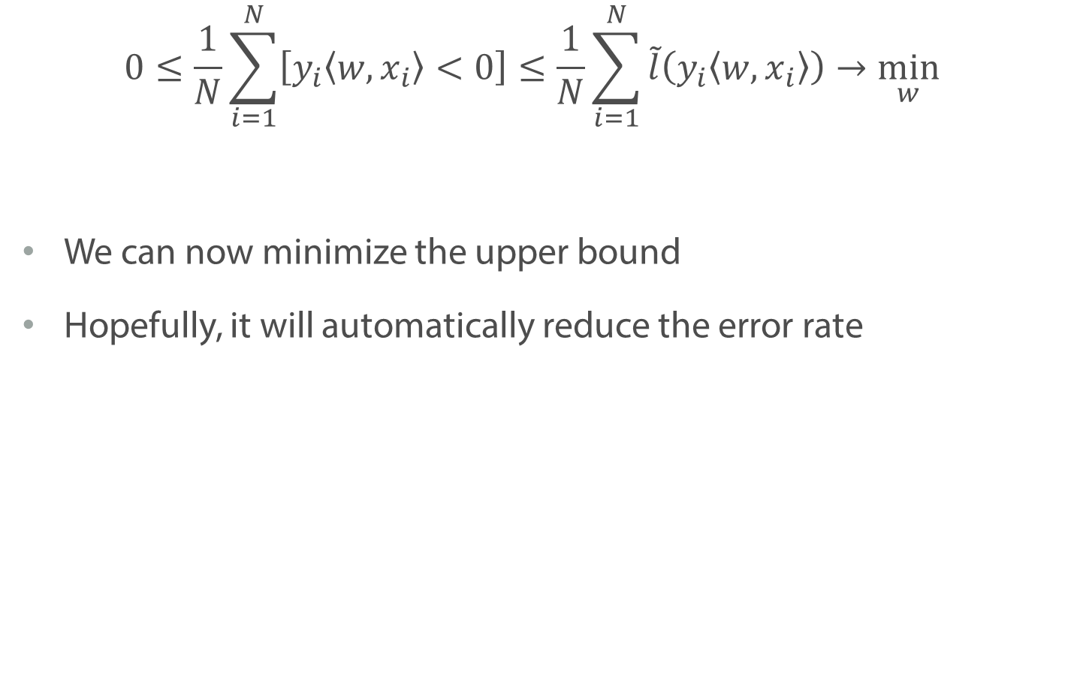
Upper Bound
$$0≤\frac{1}{N}\sum_{i=1}^{N}{\left[y_{i}\left\langle w, x_{i}\right\rangle <0\right]}≤\frac{1}{N}\sum_{i=1}^{N}{\tilde{l}\left(y_{i}\left\langle w, x_{i}\right\rangle \right)}→\min_{w}{}$$
We can now minimize the upper bound
Hopefully, it will automatically reduce the error rate

Slide 23
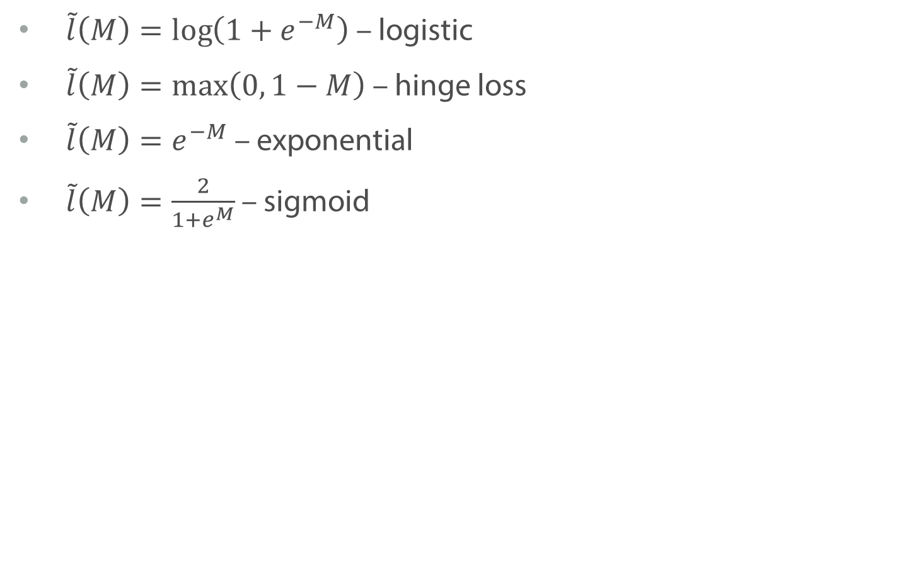
Examples of Upper Bounds
$\tilde{l}\left(M\right)=\log\left(1+e^{−M}\right)$ – logistic
$\tilde{l}\left(M\right)=\max\left(0, 1−M\right)$ – hinge loss
$\tilde{l}\left(M\right)=e^{−M}$ – exponential
$\tilde{l}\left(M\right)=\frac{2}{1+e^{M}}$ – sigmoid

Slide 24
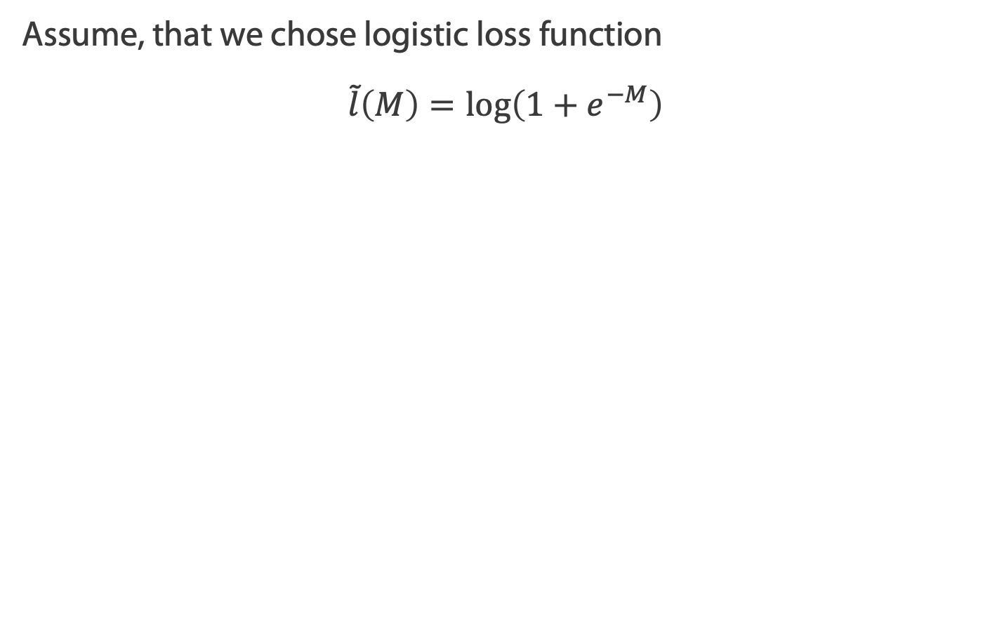
Example: logistic regression
Assume, that we chose logistic loss function
$$\tilde{l}\left(M\right)=\log\left(1+e^{−M}\right)$$

Slide 25
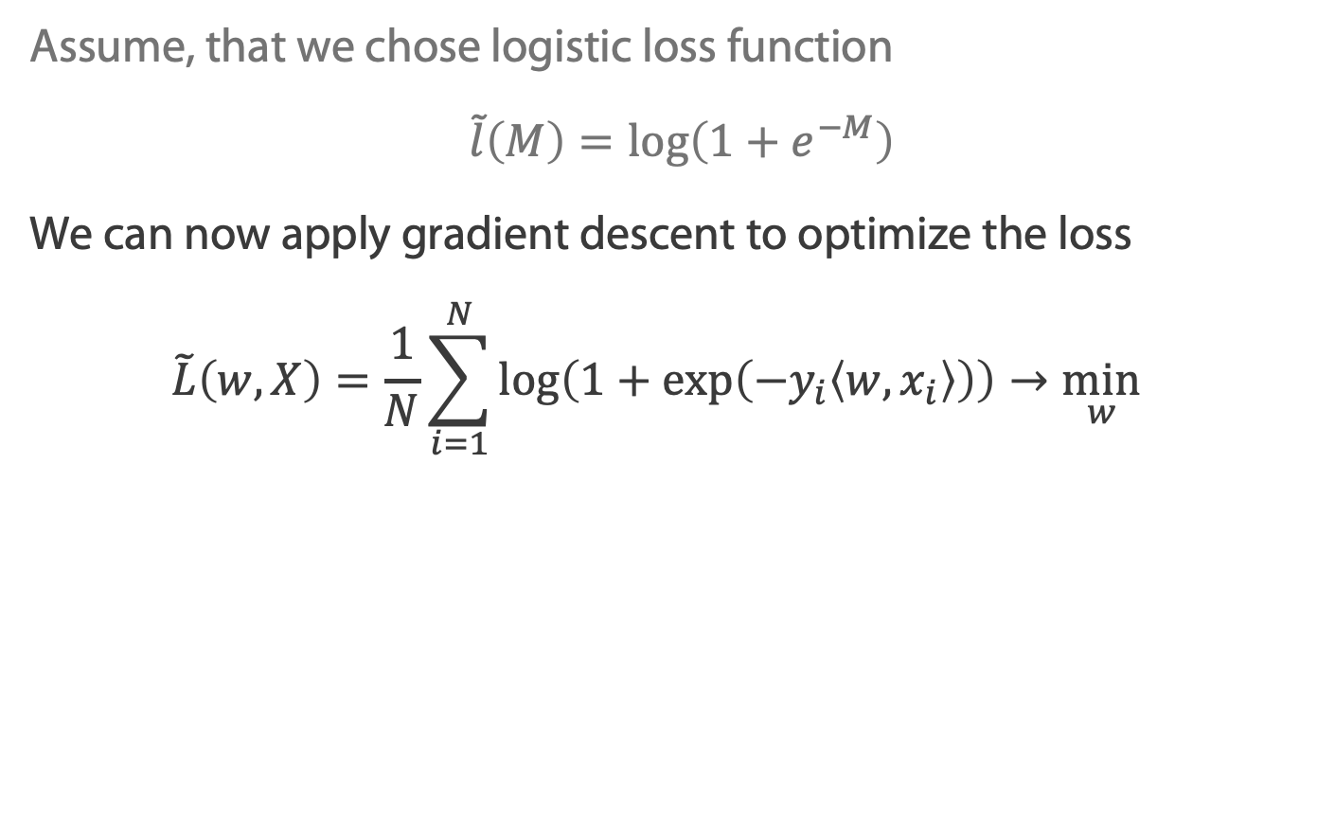
Example: logistic regression
Assume, that we chose logistic loss function
$$\tilde{l}\left(M\right)=\log\left(1+e^{−M}\right)$$
We can now apply gradient descent to optimize the loss
$$\tilde{L}\left(w, X\right)=\frac{1}{N}\sum_{i=1}^{N}{\log\left(1+\exp\left(−y_{i}\left\langle w, x_{i}\right\rangle \right)\right)}→\min_{w}{}$$

Slide 26
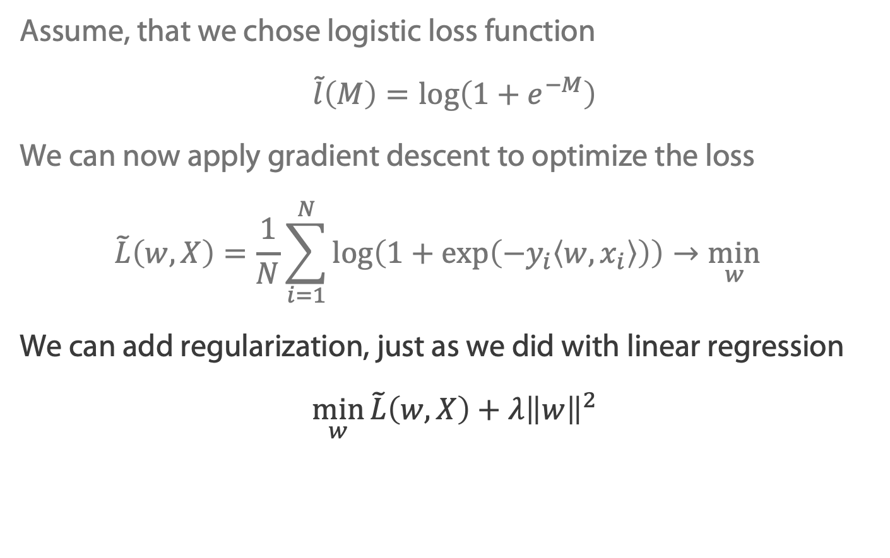
Example: logistic regression
Assume, that we chose logistic loss function
$$\tilde{l}\left(M\right)=\log\left(1+e^{−M}\right)$$
We can now apply gradient descent to optimize the loss
$$\tilde{L}\left(w, X\right)=\frac{1}{N}\sum_{i=1}^{N}{\log\left(1+\exp\left(−y_{i}\left\langle w, x_{i}\right\rangle \right)\right)}→\min_{w}{}$$
We can add regularization, just as we did with linear regression
$$\min_{w}{\tilde{L}\left(w, X\right)+λ{\left\|w\right\|}^{2}}$$

Slide 27
Summary
It is not feasible to optimize the error rate
We can upper bound the loss with some differentiable function and optimize this bound instead
From this point, we can train our model as we did last week with linear regression: use gradient descent, add regularization

Slide 28
Quality Metrics in Classification

Slide 29
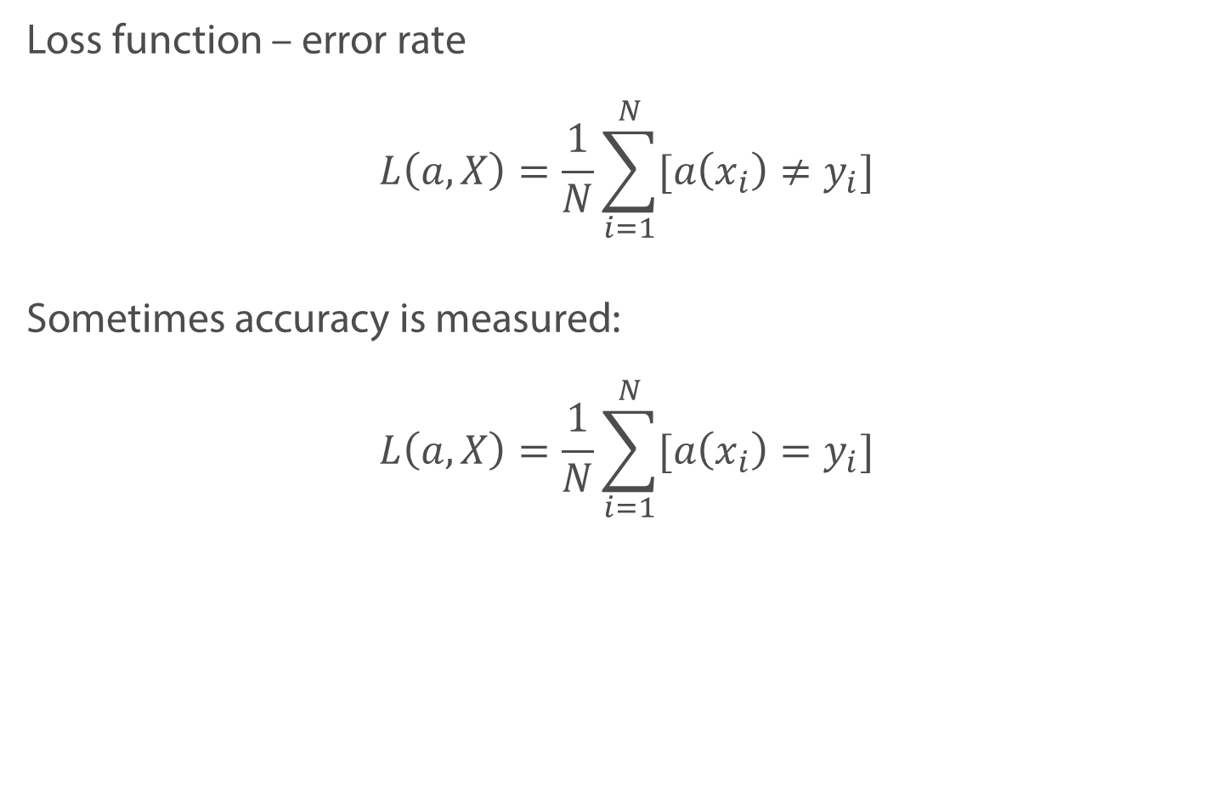
Loss function in classification
Loss function – error rate
$$L\left(a, X\right)=\frac{1}{N}\sum_{i=1}^{N}{[a\left(x_{i}\right)≠y_{i}]}$$
Sometimes accuracy is measured:
$$L\left(a, X\right)=\frac{1}{N}\sum_{i=1}^{N}{[a\left(x_{i}\right)=y_{i}]}$$

Slide 30
Accuracy and Imbalanced Datasets
Imbalanced Dataset – when one class has more observations than another one
Examples:
Predicting that the user will click on the ad
Medical diagnostics

Slide 31
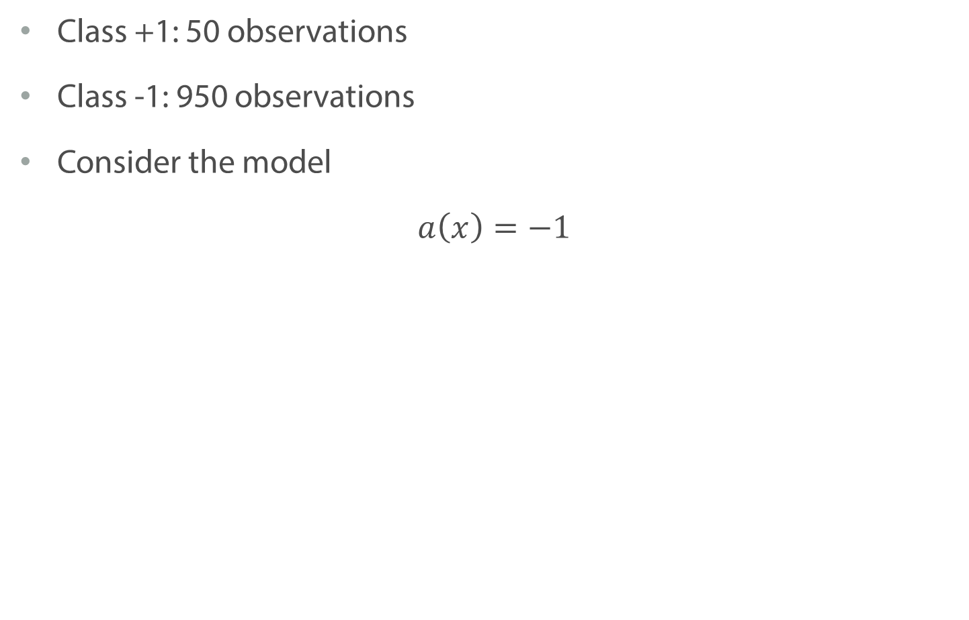
Imbalanced Datasets: examples
Class +1: 50 observations
Class -1: 950 observations
Consider the model
$$a\left(x\right)=−1$$

Slide 32
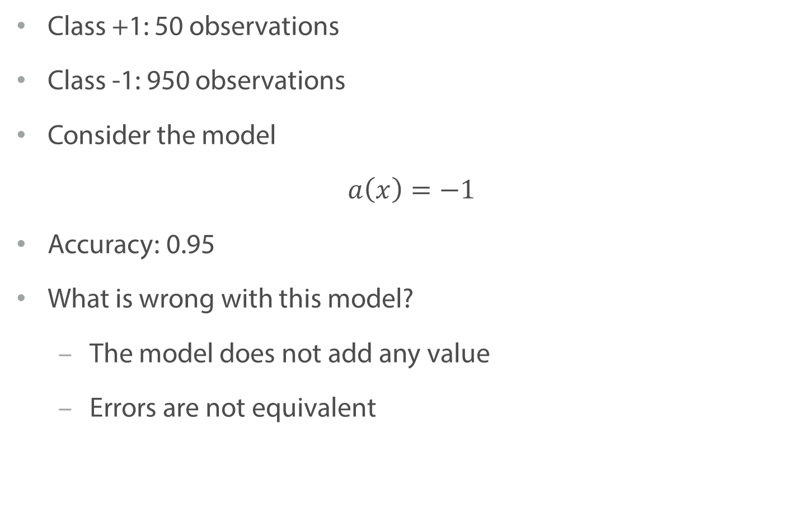
Imbalanced Datasets: examples
Class +1: 50 observations
Class -1: 950 observations
Consider the model
$$a\left(x\right)=−1$$
Accuracy: 0.95
What is wrong with this model?
The model does not add any value
Errors are not equivalent

Slide 33
Credit scoring
Model 1: gives 100 loans
80 pay-off
20 defaults
Model 2: gives 50 loans
48 pay-off
2 defaults
Which one is better?

Slide 34
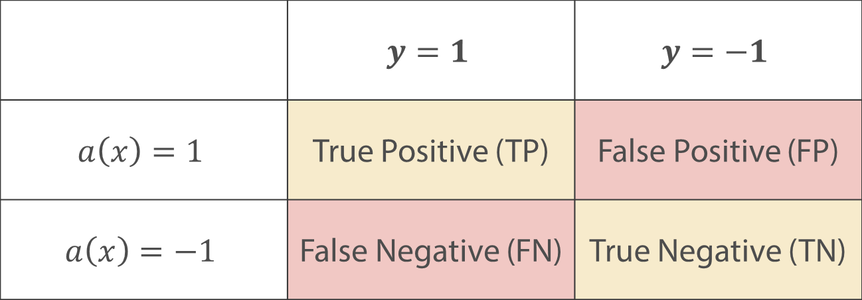
Confusion Matrix
 | $$y=1$$ | $$y=−1$$
$$a\left(x\right)=1$$ | True Positive (TP) | False Positive (FP)
$$a\left(x\right)=−1$$ | False Negative (FN) | True Negative (TN)

Slide 35
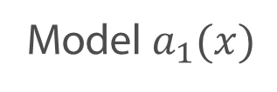
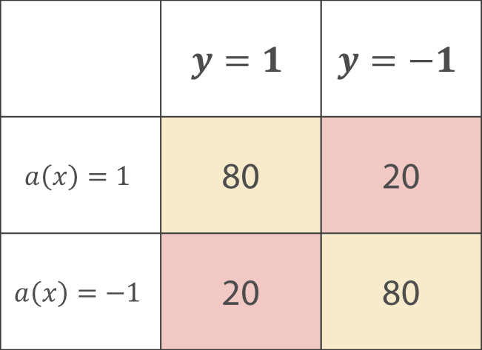
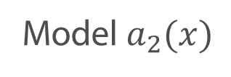
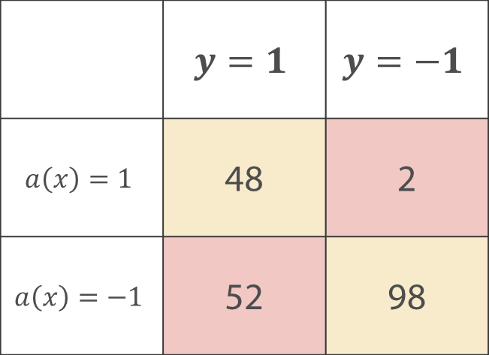
Confusion Matrix
Model $a_{1}(x)$
Model $a_{2}(x)$
 | $$y=1$$ | $$y=−1$$
$$a\left(x\right)=1$$ | 80 | 20
$$a\left(x\right)=−1$$ | 20 | 80
 | $$y=1$$ | $$y=−1$$
$$a\left(x\right)=1$$ | 48 | 2
$$a\left(x\right)=−1$$ | 52 | 98

Slide 36
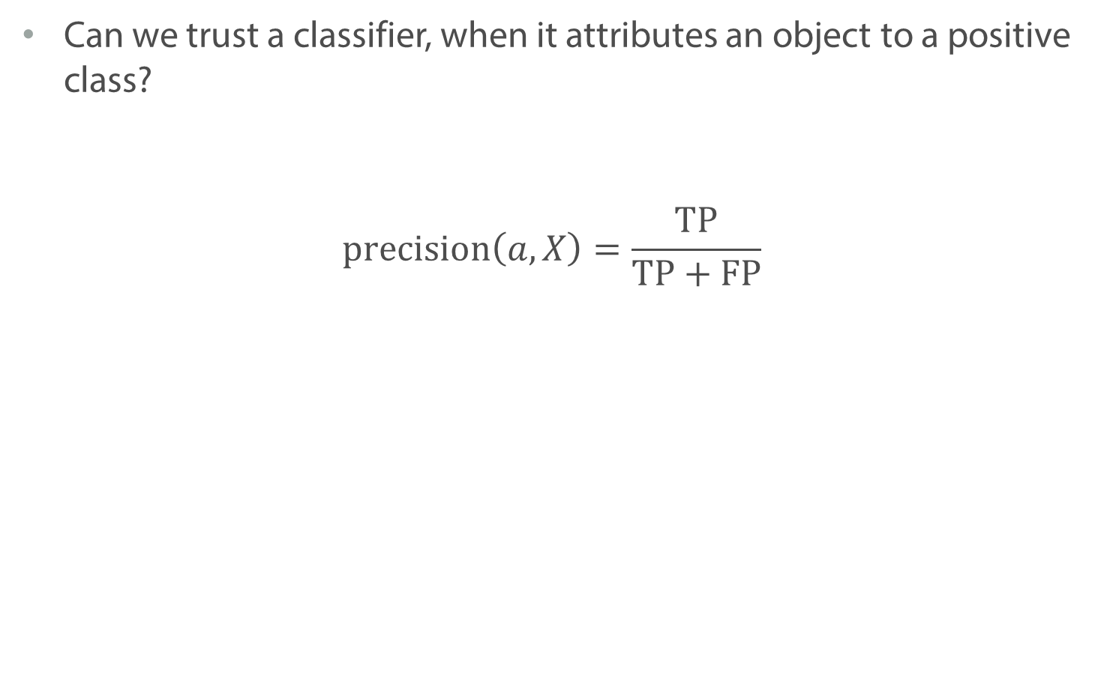
Precision
Can we trust a classifier, when it attributes an object to a positive class?
$$\text{precision}\left(a, X\right)=\frac{\text{TP}}{\text{TP}+\text{FP}}$$

Slide 37
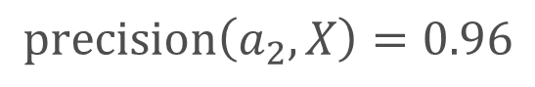
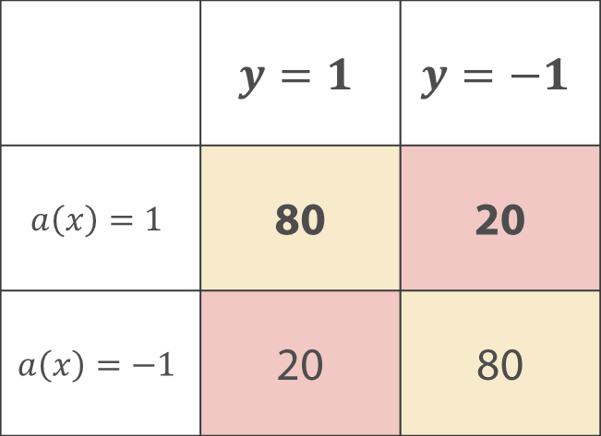
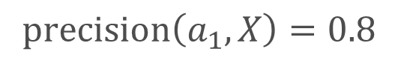
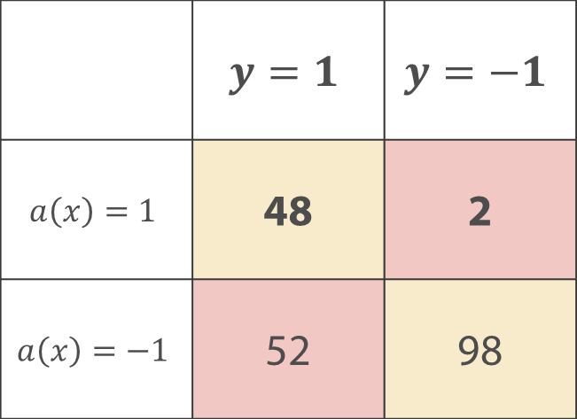
Precision
Model $a_{1}(x)$
Model $a_{2}(x)$
 | $$y=1$$ | $$y=−1$$
$$a\left(x\right)=1$$ | 80 | 20
$$a\left(x\right)=−1$$ | 20 | 80
 | $$y=1$$ | $$y=−1$$
$$a\left(x\right)=1$$ | 48 | 2
$$a\left(x\right)=−1$$ | 52 | 98
$$\text{precision}\left(a_{1},X\right)=0.8$$
$$\text{precision}\left(a_{2},X\right)=0.96$$

Slide 38
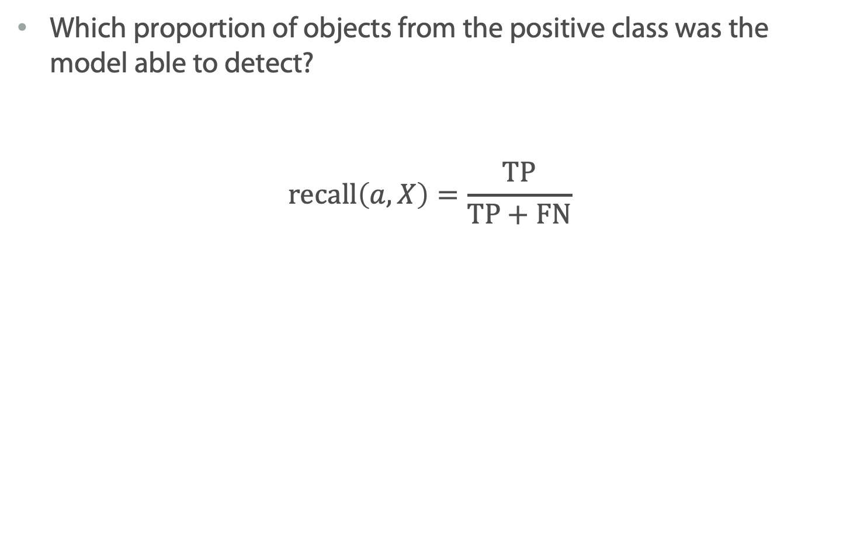
Recall
Which proportion of objects from the positive class was the model able to detect?
$$\text{r}\text{ecall}\left(a, X\right)=\frac{\text{TP}}{\text{TP}+\text{FN}}$$

Slide 39
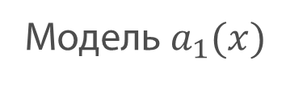
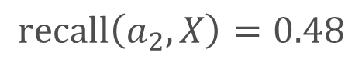
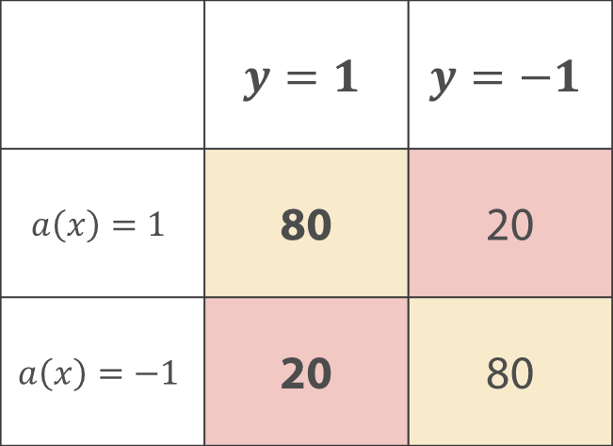
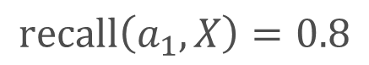


Recall
Модель $a_{1}(x)$
Модель $a_{2}(x)$
 | $$y=1$$ | $$y=−1$$
$$a\left(x\right)=1$$ | 80 | 20
$$a\left(x\right)=−1$$ | 20 | 80
 | $$y=1$$ | $$y=−1$$
$$a\left(x\right)=1$$ | 48 | 2
$$a\left(x\right)=−1$$ | 52 | 98
$$\text{recall}\left(a_{1},X\right)=0.8$$
$$\text{recall}\left(a_{2},X\right)=0.48$$

Slide 40
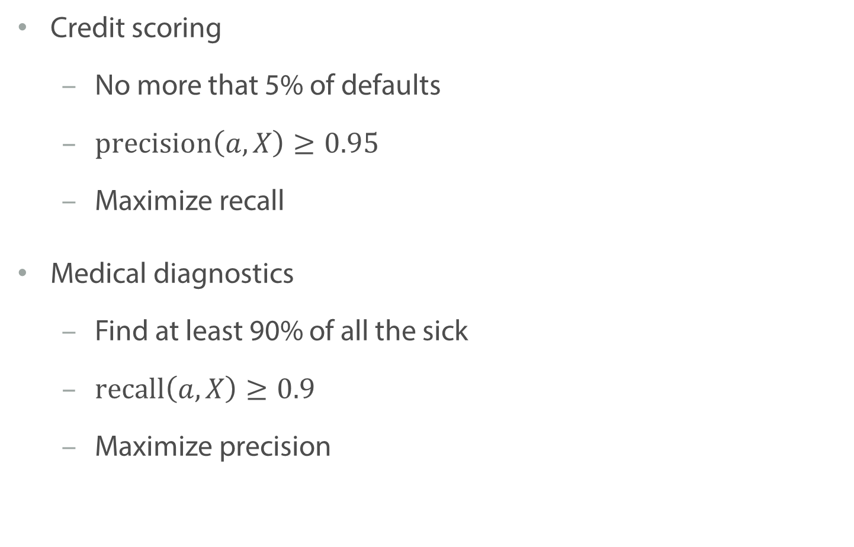
Examples
Credit scoring
No more that 5% of defaults
$\text{precision}\left(a, X\right)≥0.95$
Maximize recall
Medical diagnostics
Find at least 90% of all the sick
$\text{recall}\left(a, X\right)≥0.9$
Maximize precision

Slide 41
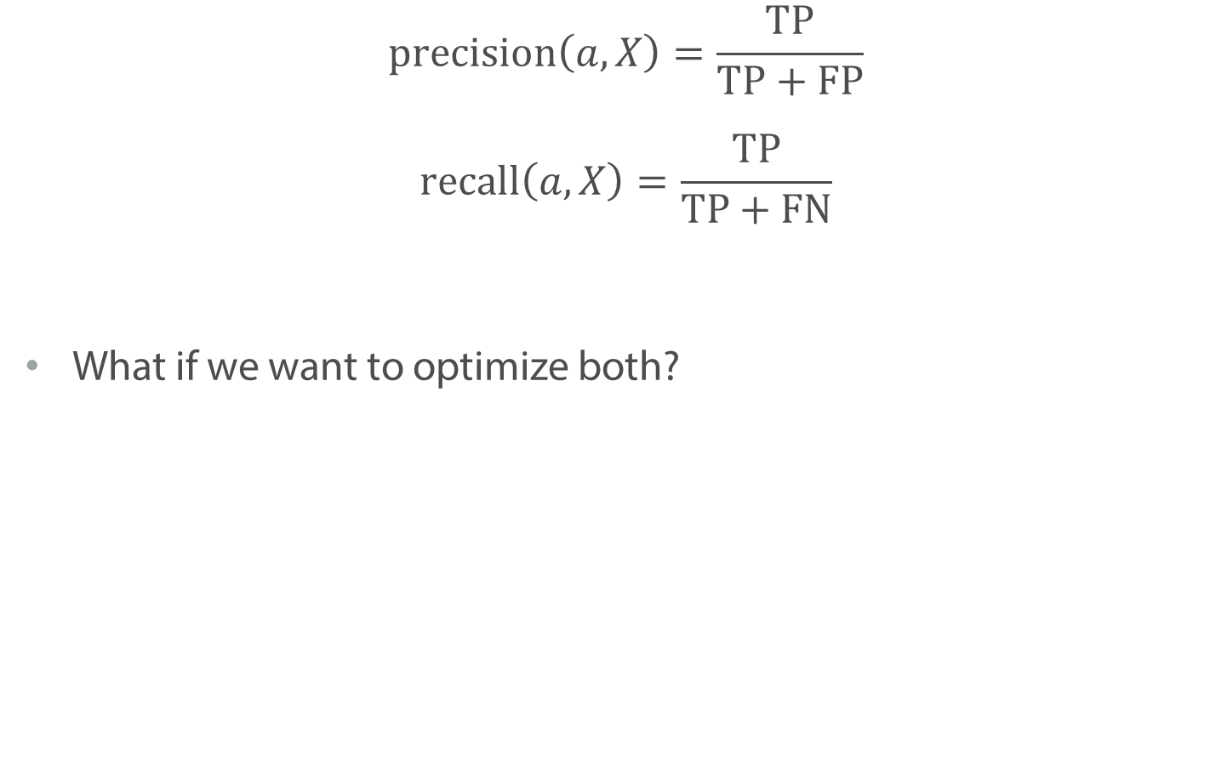
Precision and Recall
$$\text{precision}\left(a, X\right)=\frac{\text{TP}}{\text{TP}+\text{FP}}$$
$$\text{recall}\left(a, X\right)=\frac{\text{TP}}{\text{TP}+\text{FN}}$$
What if we want to optimize both?

Slide 42
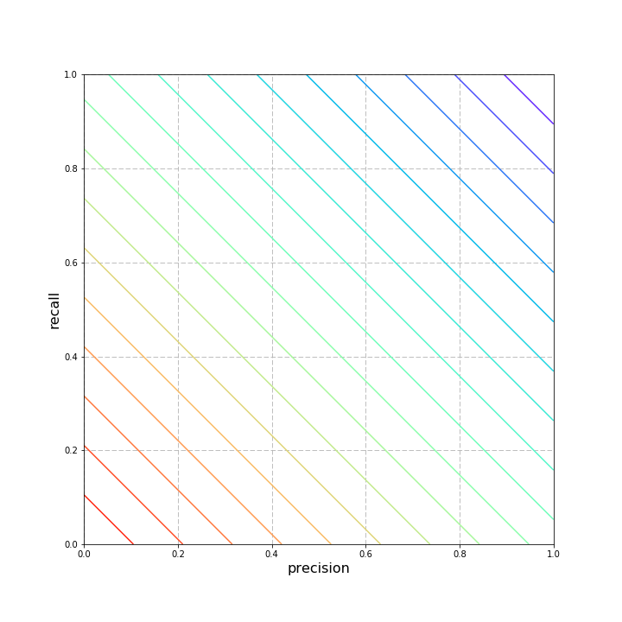
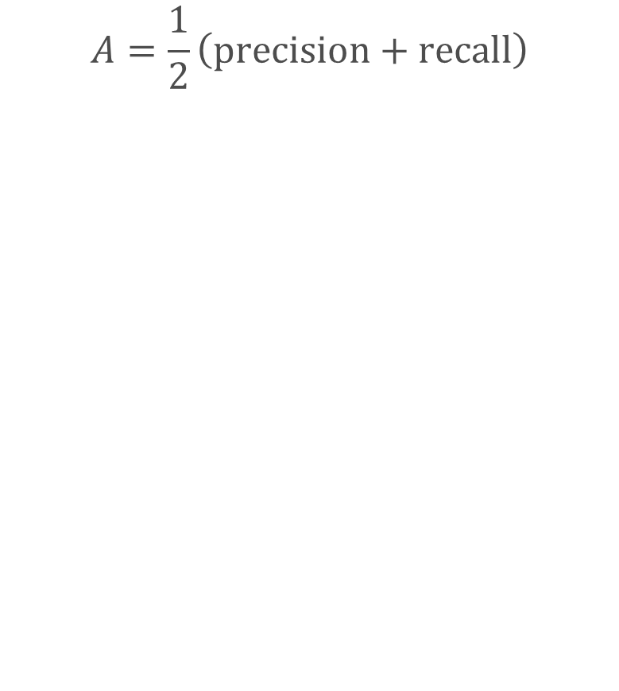
Average
$$A=\frac{1}{2}\left(\text{precision}+\text{recall}\right)$$

Slide 43
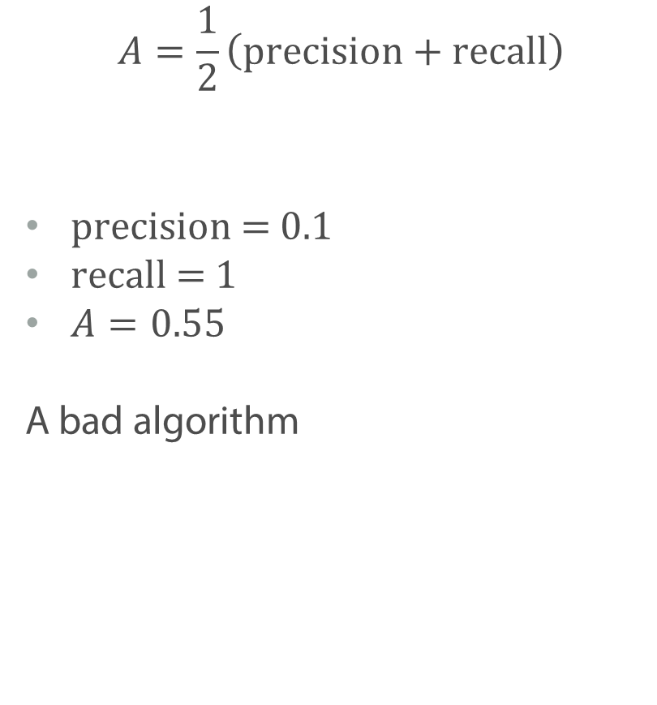
Average
$$A=\frac{1}{2}\left(\text{precision}+\text{recall}\right)$$
$\text{precision}\text{ = 0.1}$
$\text{recall}\text{ = 1}$
$A=0.55$
A bad algorithm

Slide 44
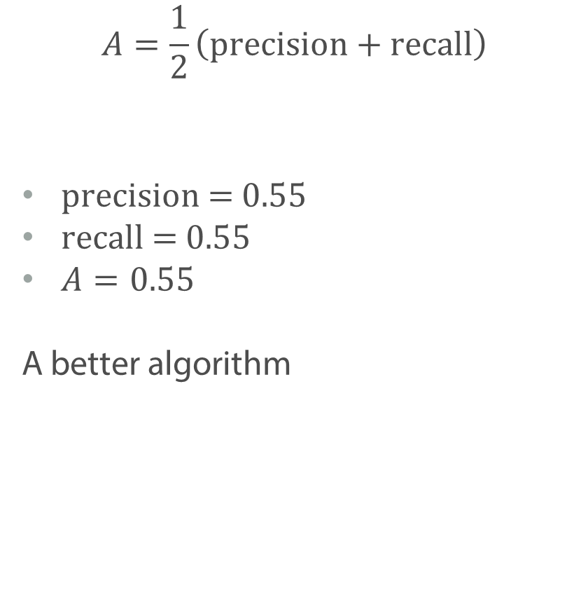
Average
$$A=\frac{1}{2}\left(\text{precision}+\text{recall}\right)$$
$\text{precision}\text{ = 0.55}$
$\text{recall}\text{ = 0.55}$
$A=0.55$
A better algorithm

Slide 45


$F_{1}$ score (harmonic mean)
$$F=\frac{2∗\text{precision}∗\text{recall}}{\text{precision}+\text{recall}}$$

Slide 46

$F_{1}$ score (harmonic mean)
$$F=\frac{2∗\text{precision}∗\text{recall}}{\text{precision}+\text{recall}}$$
$\text{precision}\text{ = 0.1, }\text{recall}\text{ = 1}$
$F=0.18$
$\text{precision}\text{ = 0.55, }\text{recall}\text{ = 0.55}$
$F=0.55$
$\text{precision}\text{ = 0.55, }\text{recall}\text{ = 0.8}$
$F=0.652$

Slide 47

$F_{β}$ score
$$F=\frac{(1+β^{2})∗\text{precision}∗\text{recall}}{β^{2}∗\text{prec}\text{ision}+\text{recall}}$$

Slide 48


$F_{β}$ score
$$F=\frac{(1+β^{2})∗\text{precision}∗\text{recall}}{β^{2}∗\text{prec}\text{ision}+\text{recall}}$$
$β=0.5$ – precision is more important

Slide 49

$F_{β}$ score
$$F=\frac{(1+β^{2})∗\text{precision}∗\text{recall}}{β^{2}∗\text{prec}\text{ision}+\text{recall}}$$
$β=2$ – recall is more important

Slide 50
Summary
Accuracy is a very convenient metrics, but sometimes it is not the best way to assess quality of a model
To distinguish between different errors one can use precision and recall
Moreover, we can combine them into one metric, e.g. use harmonic mean

Slide 51
Precision-Recall Curve

Slide 52

Linear Classifier and Threshold
Classifier
$$a\left(x\right)=\text{sign}\left(b(x)−t\right)=2\left[b(x)>t\right]−1$$
Linear classifier:
$$a\left(x\right)=\text{sign}\left(\left\langle w,x\right\rangle −t\right)=2\left[\left\langle w,x\right\rangle >t\right]−1$$

Slide 53

Linear Classifier and Threshold
Classifier
$$a\left(x\right)=\text{sign}\left(b(x)−t\right)=2\left[b(x)>t\right]−1$$
Linear classifier:
$$a\left(x\right)=\text{sign}\left(\left\langle w,x\right\rangle −t\right)=2\left[\left\langle w,x\right\rangle >t\right]−1$$
$\left\langle w,x\right\rangle$ – assesses the possibility of the class +1
How to choose $t$?
How to evaluate $b(x)$?

Slide 54

Linear Classifier and Threshold
Classifier
$$a\left(x\right)=\text{sign}\left(b(x)−t\right)=2\left[b(x)>t\right]−1$$
Linear classifier:
$$a\left(x\right)=\text{sign}\left(\left\langle w,x\right\rangle −t\right)=2\left[\left\langle w,x\right\rangle >t\right]−1$$
$\left\langle w,x\right\rangle$ – assesses the possibility of the class +1
How to choose $t$? Based on precision and recall
How to evaluate $b(x)$?

Slide 55


Threshold examples
$$a\left(x\right)=\text{sign}\left(b(x)−t\right)$$
$$y$$ | -1 | -1 | +1 | +1 | -1 | -1 | +1 | +1 | -1 | +1
$$b(x)$$ | 0.01 | 0.09 | 0.12 | 0.15 | 0.29 | 0.4 | 0.48 | 0.6 | 0.83 | 0.9

Slide 56


Threshold examples
$$a\left(x\right)=\text{sign}\left(b(x)−t\right)$$
$$y$$ | -1 | -1 | +1 | +1 | -1 | -1 | +1 | +1 | -1 | +1
$$b(x)$$ | 0.01 | 0.09 | 0.12 | 0.15 | 0.29 | 0.4 | 0.48 | 0.6 | 0.83 | 0.9
$$a(x)$$ | -1 | -1 | -1 | -1 | -1 | -1 | +1 | +1 | +1 | +1
$$t=0.45$$
$p\text{recision}$= $\frac{\text{3}}{\text{3}+\text{1}}=0.75$
$\text{recall}$ = $\frac{\text{3}}{\text{3}+\text{2}}=0.6$

Slide 57


Threshold examples
$$a\left(x\right)=\text{sign}\left(b(x)−t\right)$$
$$y$$ | -1 | -1 | +1 | +1 | -1 | -1 | +1 | +1 | -1 | +1
$$b(x)$$ | 0.01 | 0.09 | 0.12 | 0.15 | 0.29 | 0.4 | 0.48 | 0.6 | 0.83 | 0.9
$$a(x)$$ | -1 | -1 | +1 | +1 | +1 | +1 | +1 | +1 | +1 | +1
$$t=0.1$$
$p\text{recision}$= $\frac{\text{5}}{\text{5}+\text{3}}=0.625$
$\text{recall}$ = $\frac{\text{5}}{\text{5}+\text{0}}=1$

Slide 58

Linear Classifier and Threshold
Classifier
$$a\left(x\right)=\text{sign}\left(b(x)−t\right)=2\left[b(x)>t\right]−1$$
Linear classifier:
$$a\left(x\right)=\text{sign}\left(\left\langle w,x\right\rangle −t\right)=2\left[\left\langle w,x\right\rangle >t\right]−1$$
$\left\langle w,x\right\rangle$ – assesses the possibility of the class +1
How to choose $t$? Based on precision and recall
How to evaluate $b(x)$?

Slide 59

PR-curve
X-axis – recall
Y-axis – precision
Each point – values of precision and recall for different thresholds

Slide 60
PR-curve
Left point: (0, 0)
The largest threshold
No points in the positive class

Slide 61

PR-curve
Left point: (0, 0)
The largest threshold
No points in the positive class
Right point: $(1, r)$
$r$ – proportion of objects in positive class
The lowest threshold
All the points are predicted to be positive

Slide 62

PR-curve
Left point: (0, 0)
The largest threshold
No points in the positive class
Right point: $(1, r)$
$r$ – proportion of objects in positive class
The lowest threshold
All the points are predicted to be positive
Ideal classifier – goes through the point (1, 1)
AUC-PRC – area under PR-curve

Slide 63


AUC-PRC
Model 1:
AUC-PRC = 0.78
Model 2:
AUC-PRC = 0.97

Slide 64
Summary
It is useful to evaluate how well the algorithm ranges the objects before choosing the threshold
Area under PR-curve is one way to do that

Slide 65
Area Under ROC-curve

Slide 66

Area Under PR-curve
$\text{precision}=\frac{TP}{TP+FP}$; $\text{recall}=\frac{TP}{TP+FN}$
Precision changes, depending on a class balance
AUC-PRC of an ideal algorithm changes depending on the class balance
Easier to interpret in case of imbalanced dataset
Better if we are interested in precision and recall

Slide 67


ROC-curve
Receiver Operating Characteristic
X-axis – False Positive Rate
$$FPR=\frac{FP}{FP+TN}$$
Y-axis – True Positive Rate (Recall)
$$TPR=\frac{TP}{TP+FN}$$

Slide 68
ROC-curve
Receiver Operating Characteristic
X-axis – False Positive Rate
$$FPR=\frac{FP}{FP+TN}$$
Y-axis – True Positive Rate (Recall)
$$TPR=\frac{TP}{TP+FN}$$
Number of objects in class -1
Number of objects in class +1

Slide 69


ROC-curve
Left point: (0, 0)
Right point: (1, 1)
Idea classifier goes through (0, 1)
AUC-ROC – area under ROC-curve

Slide 70

Area Under ROC-curve
$FPR=\frac{FP}{FP+TN}$; $TPR=\frac{TP}{TP+FN}$
FPR and TPR are normalized to the class size
AUC-ROC does not change if classes are imbalanced
AUC-ROC of a ideal classifier is 1

Slide 71


Example: AUC-ROC and AUC-PR
$$b(x)$$
$$y$$
AUC-ROC = 0.95
AUC-PRC = 0.001
50000 objects
y = -1
100 objects
y = +1
950000 objects
y = -1

Slide 72

Example: AUC-ROC and AUC-PR
$$b(x)$$
$$y$$
Fix a threshold
$a\left(x\right)=1$ for 50095 objects
FP = 50000, TP = 95
TPR = 0.95, FPR = 0.05
precision = 0.0019, recall = 0.95
50000 objects
y = -1
100 objects
y = +1
950000 objects
y = -1

Slide 73
Summary
Area under ROC-curve is one of the most popular metrics used to estimate the ranging quality
One have to be careful with AUC-ROC when classes are imbalanced

Slide 74
Logistic Regression

Slide 75

Logistic Regression
Binary classification task: $𝕐=\left\{−1, +1\right\}$
Linear classifier:
$$a\left(x\right)=sign\left(b\left(x\right) −t\right)=sign(\left\langle w, x\right\rangle −t)$$

Slide 76

Logistic Regression
Binary classification task: $𝕐=\left\{−1, +1\right\}$
Linear classifier:
$$a\left(x\right)=sign\left(b\left(x\right) −t\right)=sign(\left\langle w, x\right\rangle −t)$$
Error rate loss function:
$$\min_{w} \frac{1}{N}\sum_{i=1}^{N}{\left[y_{i}\left\langle w, x_{i}\right\rangle <0\right]=\min_{w} \frac{1}{N}\sum_{i=1}^{N}{\left[M_{i}<0\right]}}$$

Slide 77

Logistic Regression
Binary classification task: $𝕐=\left\{−1, +1\right\}$
Linear classifier:
$$a\left(x\right)=sign\left(b\left(x\right) −t\right)=sign(\left\langle w, x\right\rangle −t)$$
Error rate loss function:
$$\min_{w} \frac{1}{N}\sum_{i=1}^{N}{\left[y_{i}\left\langle w, x_{i}\right\rangle <0\right]=\min_{w} \frac{1}{N}\sum_{i=1}^{N}{\left[M_{i}<0\right]}}$$
We can optimize differentiable upper bound, e.g. logistic loss
$$\min_{w}{\frac{1}{N}\sum_{i=1}^{N}{\log\left(1+\exp\left(−M_{i}\right)\right)}}$$

Slide 78
Predicting Probabilities
High probability
50/50
Low probability

Slide 79

When Do We Need Probabilities?
Credit Scoring
Give loans to client with probability of default less that 10%
Internet Adds
$b\left(x\right)$ – probability that the person clicks
$c\left(x\right)$ – revenue from the ad
$c\left(x\right)b\left(x\right)$ – expected revenue, that we want to maximize

Slide 80
Predicting Probabilities
High probability
50/50
Low probability

Slide 81

Logistic Regression
Binary classification task: $𝕐=\left\{−1, +1\right\}$
Linear classifier:
$$a\left(x\right)=sign\left(b\left(x\right)\right)=sign(\left\langle w, x\right\rangle )$$
Can we use $b\left(x\right)=\left\langle w, x\right\rangle$ as a probability estimate?

Slide 82

Predicting Probabilities
$$b\left(x\right)=w_{1}x+w_{0}$$

Slide 83

Linear Classifier
Let us convert outputs of the model into [0, 1]
E.g. we can use Sigmoid function:
$$σ\left(\left\langle w, x\right\rangle \right)=\frac{1}{1+\exp\left(−\left\langle w, x\right\rangle \right)}$$

Slide 84

Sigmoid

Slide 85

Predicting Probabilities
$$b\left(x\right)=σ\left(w_{1}x+w_{0}\right)$$

Slide 86
Predicting Probabilities
High probability
50/50
Low probability

Slide 87

Logistic Regression
Binary classification task: $𝕐=\left\{−1, +1\right\}$
Predicted probabilities:
$$P\left(y_{i}=1\right)=b(x_{i})$$

Slide 88

Logistic Regression
Binary classification task: $𝕐=\left\{−1, +1\right\}$
Predicted probabilities:
$$P\left(y_{i}=1\right)=b(x_{i})$$
Use sigmoid function to map outputs to the range from 0 to 1:
$$b\left(x\right)= σ\left(\left\langle w, x\right\rangle \right)=\frac{1}{1+\exp\left(−\left\langle w, x\right\rangle \right)}$$

Slide 89

Logistic Regression
Binary classification task: $𝕐=\left\{−1, +1\right\}$
Predicted probabilities:
$$P\left(y_{i}=1\right)=b(x_{i})$$
Use sigmoid function to map outputs to the range from 0 to 1:
$$b\left(x\right)= σ\left(\left\langle w, x\right\rangle \right)=\frac{1}{1+\exp\left(−\left\langle w, x\right\rangle \right)}$$
We can now use maximum likelihood to train this model

Slide 90
Summary
In some tasks it is important to predict class probabilities
We can apply sigmoid function to the output of the model to get numbers between 0 and 1
Finally, we want to train our model in such a way, that they would be interpreted as probabilities

Slide 91
Logistic Regression: MLE

Slide 92
Logistic Regression

Slide 93

Logistic Regression
Binary classification task: $𝕐=\left\{−1, +1\right\}$
Predicted probabilities:
$$P\left(y_{i}=1\right)=b(x_{i})$$
Use sigmoid function to map outputs to the range from 0 to 1:
$$b\left(x\right)= σ\left(\left\langle w, x\right\rangle \right)=\frac{1}{1+\exp\left(−\left\langle w, x\right\rangle \right)}$$

Slide 94
Predict Probabilities
$$b\left(x\right)=σ\left(w_{1}x+w_{0}\right)$$

Slide 95

Logistic Regression
Binary classification task: $𝕐=\left\{−1, +1\right\}$
Predicted probabilities:
$$P\left(y_{i}=1\right)=b(x_{i})$$
Use sigmoid function to map outputs to the range from 0 to 1:
$$b\left(x\right)= σ\left(\left\langle w, x\right\rangle \right)=\frac{1}{1+\exp\left(−\left\langle w, x\right\rangle \right)}$$
We can train with Log-Loss:
$$\min_{w} \sum_{i=1}^{N}{\log{(1+\exp{(−y_{i}\left\langle w, x_{i}\right\rangle })}}$$

Slide 96

Logistic Regression
Upper bound on the error rate
$$\tilde{l}\left(M\right)=\log\left(1+e^{−M}\right)$$
Logistic Regression Loss:
$$\min_{w} \sum_{i=1}^{N}{\log{(1+\exp{(−y_{i}\left\langle w, x_{i}\right\rangle })}}$$
Notes:
Note that have received this upper bound for the totally different assumptions: in our derivations we never actually asked our loss to an upper bound

Slide 97

Predicting probabilities
Does Logistic Regression give us correct probabilities?
We will say that the model $b\left(x\right)$ predicts probabilities correctly, if among objects with $b\left(x\right)=p$ proportion of positive is $p$.

Slide 98

Predicting probabilities
Consider objects $x_{1},…, x_{n}$, where the $b\left(x\right)$ outputs the same probability around $p$:
$$\sum_{i=1}^{n}{l\left(y_{i}, b\left(x_{i}\right)\right)}=\sum_{i=1}^{n}{l\left(y_{i}, p\right)}$$

Slide 99

Predicting probabilities
Consider objects $x_{1},…, x_{n}$, where the $b\left(x\right)$ outputs the same probability around $p$:
$$\sum_{i=1}^{n}{l\left(y_{i}, b\left(x_{i}\right)\right)}=\sum_{i=1}^{n}{l\left(y_{i}, p\right)}$$
What is the optimal output for these objects?
$$p_{∗}=\arg{\min{\sum_{i=1}^{n}{l\left(y_{i}, p\right)}}}$$
We expect that $p_{∗}=\frac{1}{n}\sum_{i=1}^{n}{\left[y_{i}=+1\right]}$

Slide 100

Predicting probabilities: Log-Loss
Consider objects $x_{1},…, x_{n}$, where the $b\left(x\right)$ outputs the same probability around $p$:
$$\sum_{i=1}^{n}{l\left(y_{i}, b\left(x_{i}\right)\right)}=\sum_{i=1}^{n}{l\left(y_{i}, p\right)}$$
Which output logistic regression would have on these objects?
$$p_{∗}=\arg{\min{\sum_{i}{\left\{−\left[y_{i}=+1\right]\log{p}−\left[y_{i}=−1\right]\log{(1−p)}\right\}}}}$$

Slide 101

Log-loss
$$p_{∗}=\arg{\min{\sum_{i}{\left\{−\left[y_{i}=+1\right]\log{p}−\left[y_{i}=−1\right]\log{(1−p)}\right\}}}}$$
Calculate the derivative and find optimal probability:
$$\sum_{i}{\left\{−\frac{\left[y_{i}=+1\right]}{p}+\frac{\left[y_{i}=−1\right]}{1−p }\right\}}=−\frac{n_{+}}{p}+\frac{n_{−}}{1−p} =0$$
$$p_{∗}=\frac{n_{+}}{n_{+}+n_{−}}=\frac{1}{n}\sum_{i=1}^{n}{\left[y_{i}=+1\right]}$$

Slide 102

Predicting probabilities: Log-Loss
We assume that the model gives correct probabilities if for any set $y_{1},…, y_{n}∈𝕐$
$$\arg{\min{\sum_{i=1}^{n}{l\left(y_{i}, p\right)}}}=\frac{1}{n}\sum_{i=1}^{n}{\left[y_{i}=+1\right]}$$
This is a condition on a loss function (we can check it for Log-Loss, MSE, MAE, etc.)
It holds for Log-Loss
Logistic Regression gives us correct probabilities

Slide 103
Summary
We can formulate the condition that the model estimates the probabilities correctly
Choose loss functions which satisfy this condition
Log-loss is one example of such loss
Another example is MSE, but MSE works poorly with classification tasks

Slide 104
Support Vector Machine

Slide 105

Linear classifier and Hinge Loss
Binary classification task: $𝕐=\left\{−1, +1\right\}$
We can optimize differentiable upper bound, e.g. hinge loss
$$\min_{w}{\frac{1}{N}\sum_{i=1}^{N}{\max\left(0, 1−M_{i}\right)}}$$

Slide 106
Which classifier is better?

Slide 107

Margin of a classifier
Recall that linear classifier defines a hyperplane
$$\left\langle w, x\right\rangle =0$$
The distance from the any point $x$ to this hyperplane is:
$$\frac{\left|\left\langle w, x\right\rangle \right| }{\left\|w\right\|}$$

Slide 108

Margin of a classifier
Recall that linear classifier defines a hyperplane
$$\left\langle w, x\right\rangle =0$$
The distance from any point $x$ to this hyperplane is:
$$\frac{\left|\left\langle w, x\right\rangle \right| }{\left\|w\right\|}$$
Margin of a classifier – distance from the hyperplane to the nearest object in the dataset

Slide 109
Choose the model with the largest margin

Slide 110
Extra Conditions Needed

Slide 111
Margin of a classifier
We will maximize margin of the classifier – distance to the nearest object
Trying not to make mistakes at the same time

Slide 112
Linearly Separable Case
Notes:
Существует линейный классификатор, не допускающий ни одной ошибки

Slide 113

Linearly Separable Case
Condition 1: Maximal margin
The distance form any point $x$ to the hyperplane is:
$$\frac{\left|\left\langle w, x\right\rangle \right| }{\left\|w\right\|}$$
Margin of a classifier:
$$\min_{i=1, …,N}{\frac{\left|\left\langle w, x_{i}\right\rangle \right| }{\left\|w\right\|}}$$

Slide 114

Linearly Separable Case
Condition 1: Maximal margin
The distance form any point $x$ to the hyperplane is:
$$\frac{\left|\left\langle w, x\right\rangle \right| }{\left\|w\right\|}$$
Margin of a classifier:
$$\min_{i=1, …,N}{\frac{\left|\left\langle w, x_{i}\right\rangle \right| }{\left\|w\right\|}}$$
Condition 2: No mistakes
$$y_{i}\left\langle w, x_{i}\right\rangle >0,i=1, …, N$$

Slide 115

Simple assumption
For a linear classifier:
$$a\left(x\right)=\text{sign} (\left\langle w, x_{i}\right\rangle )$$
If we divide $w$ by a scalar $a>0$, the output will not change:
$$a\left(x\right)=\text{sign} \left(\frac{\left\langle w, x_{i}\right\rangle }{a}\right)=\text{sign} \left(\left\langle w, x_{i}\right\rangle \right)$$

Slide 116

Simple assumption
For a linear classifier:
$$a\left(x\right)=\text{sign} (\left\langle w, x_{i}\right\rangle )$$
If we divide $w$ by a scalar $a>0$, the output will not change:
$$a\left(x\right)=\text{sign} \left(\frac{\left\langle w, x_{i}\right\rangle }{a}\right)=\text{sign} \left(\left\langle w, x_{i}\right\rangle \right)$$
Let us divide $w$ b$y\min_{i=1, …,ℓ}\left|\left\langle w, x_{i}\right\rangle \right|>0$, as a result:
$$\min_{i=1, …,ℓ}\left|\left\langle \tilde{w}, x_{i}\right\rangle \right|=1,$$
$$where \tilde{w}= \frac{w}{\min_{i=1, …,ℓ}\left|\left\langle w, x_{i}\right\rangle \right|}$$

Slide 117

Margin of
Margin of a Classifier
Margin of a classifier:
$$\min_{i=1, …,N}{\frac{\left|\left\langle w, x_{i}\right\rangle \right| }{\left\|w\right\|}}$$
Given our assumption that
$$\min_{i=1, …,ℓ}\left|\left\langle w, x_{i}\right\rangle \right|=1$$
The resulting margin is:
$$\min_{i=1, …,N}{\frac{\left|\left\langle w, x_{i}\right\rangle \right| }{\left\|w\right\|}}=\frac{\min_{i=1, …,N}\left|\left\langle w, x_{i}\right\rangle \right|}{\left\|w\right\|}=\frac{1}{\left\|w\right\|}$$

Slide 118

Linearly Separable Case
Condition 1: Maximal margin
$$\max_{w} \frac{1}{\left\|w\right\|}$$
Condition 2: No mistakes
$$y_{i}\left\langle w, x_{i}\right\rangle >0,i=1, …, N$$

Slide 119

Linearly Separable Case
Condition 1: Maximal margin
$$\max_{w} \frac{1}{\left\|w\right\|}$$
Condition 2: No mistakes
$$y_{i}\left\langle w, x_{i}\right\rangle >0,i=1, …, N$$
Condition 3: $\min_{i=1, …,N}\left|\left\langle w, x_{i}\right\rangle \right|=1$

Slide 120

Linearly Separable Case
Condition 1: Maximal margin
$$\max_{w} \frac{1}{\left\|w\right\|}$$
Condition 2: No mistakes
$$y_{i}\left\langle w, x_{i}\right\rangle >0,i=1, …, N$$
Condition 3: $\left|\left\langle w, x_{i}\right\rangle \right| ≥1,i=1, …, N$

Slide 121

Linearly Separable Case
Condition 1: Maximal margin
$$\max_{w} \frac{1}{\left\|w\right\|}$$
Condition 2: No mistakes
$$y_{i}\left\langle w, x_{i}\right\rangle >0,i=1, …, N$$
Condition 3: $\left|\left\langle w, x_{i}\right\rangle \right| ≥1,i=1, …, N$
Conditions 2 and 3 together:
$$y_{i}\left\langle w, x_{i}\right\rangle ≥1,i=1, …, N$$

Slide 122


Linearly Separable Case
Condition 1: Maximal margin
$$\max_{w} \frac{1}{\left\|w\right\|}$$
Conditions 2 and 3 together:
$$y_{i}\left\langle w, x_{i}\right\rangle ≥1,i=1, …, N$$
The final optimization problem:
$$\left\{\begin{aligned}\min_{w}{\left\|w\right\|}^{2} \\ y_{i}\left\langle w, x_{i}\right\rangle ≥1 \end{aligned}\right.$$

Slide 123
Linearly Non-Separable Case

Slide 124

Linearly Non-Separable Case
$\text{Any} \text{linear} \text{classifier} \text{will} \text{make} \text{at} \text{least} \text{one} \text{error}\text{:}$
$$\left\{\begin{aligned}\min_{w}{\left\|w\right\|}^{2} \\ y_{i}\left\langle w, x_{i}\right\rangle ≥1 \end{aligned}\right.$$

Slide 125

Linearly Non-Separable Case
$\text{Any} \text{linear} \text{classifier} \text{will} \text{make} \text{at} \text{least} \text{one} \text{error}\text{:}$
$$\left\{\begin{aligned}\min_{w}{\left\|w\right\|}^{2} \\ y_{i}\left\langle w, x_{i}\right\rangle ≥1 \end{aligned}\right.$$
$\text{Let} \text{us} \text{soften} \text{this} \text{requirement}$
$$\left\{\begin{aligned}\min_{w}{\left\|w\right\|}^{2} \\ y_{i}\left\langle w, x_{i}\right\rangle ≥1−ξ_{i} \\ ξ_{i}≥0\end{aligned}\right.$$

Slide 126

Will it work?
$$\left\{\begin{aligned}\min_{w}{\left\|w\right\|}^{2} \\ y_{i}\left(\left\langle w, x_{i}\right\rangle \right)≥1−{10}^{1000}\end{aligned}\right.$$

Slide 127

Support Vector Machine
$$\left\{\begin{aligned}{\min_{w,ξ_{i}}\left\|w\right\|}^{2}+C\sum_{i=1}^{ℓ}{ξ_{i}} \\ y_{i}\left\langle w, x_{i}\right\rangle ≥1−ξ_{i} \\ ξ_{i}≥0\end{aligned}\right.$$

Slide 128
Linearly Non-Separable Case
Small C

Slide 129
Linearly Non-Separable Case
Large C

Slide 130

Support Vector Machine
$$\left\{\begin{aligned}{\min_{w,ξ_{i}}\left\|w\right\|}^{2}+C\sum_{i=1}^{ℓ}{ξ_{i}} \\ y_{i}\left\langle w, x_{i}\right\rangle ≥1−ξ_{i} \\ ξ_{i}≥0\end{aligned}\right.$$
Let’s combine the two conditions:
$$ξ_{i}≥\max\left(0, 1−y_{i}\left\langle w, x_{i}\right\rangle \right)$$

Slide 131

Support Vector Machine
$$\left\{\begin{aligned}{\min_{w,ξ_{i}}\left\|w\right\|}^{2}+C\sum_{i=1}^{ℓ}{ξ_{i}} \\ y_{i}\left\langle w, x_{i}\right\rangle ≥1−ξ_{i} \\ ξ_{i}≥0\end{aligned}\right.$$
Let’s combine the two conditions:
$$ξ_{i}≥\max\left(0, 1−y_{i}\left\langle w, x_{i}\right\rangle \right)$$
And rewrite the optimization task:
$${\min_{w }\left\|w\right\|}^{2}+C\sum_{i=1}^{ℓ}{\max\left(0, 1−y_{i}\left\langle w, x_{i}\right\rangle \right)}$$

Slide 132

Support Vector Machine
Rewrite the optimization task:
$${\min_{w }\left\|w\right\|}^{2}+C\sum_{i=1}^{ℓ}{\max\left(0, 1−y_{i}\left\langle w, x_{i}\right\rangle \right)}$$
Hinge Loss with regularization
$${\min_{w }\sum_{i=1}^{ℓ}{\max\left(0, 1−y_{i}\left\langle w, x_{i}\right\rangle \right)}+ λ\left\|w\right\|}^{2}$$

Slide 133
Logistic Regression and SVM

Slide 134
Summary
Support Vector Machine is based on the idea of largest margin of a classifier
In the linearly non-separable case, we have to decide, what is more important – the width of a margin or the number of errors
SVM is analogous to Hinge loss with regularization

